Slide 1
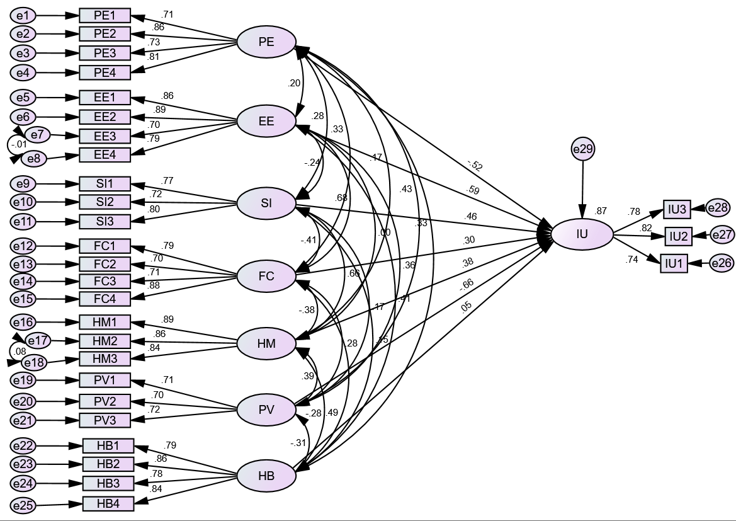
Intention to use smartphone pregnancy apps and predictors among pregnant women attending ANC service in Dessie city and Kombolcha town public health facilities, north-east Ethiopia, 2024. An extended Unified Theory of Acceptance and Use of Technology model-based framework
Shimels Derso Kebede*, Yawkal Tsega*, Mandefro Asfaw Geremew*, Ermias Bekele Enyew*
Affiliations * College of Medicine and Health Sciences, Wollo University
Background
Results
Gaining high-quality information impractical during pregnancy mainly due to challenges in low resource settings such as lack of health facilities, dearth of skilled medical practitioners, and others.
These days latest generation of smartphones allows the development of new applications in healthcare and pregnant women frequently use the Internet and smartphone applications as a source of information throughout their pregnancy.
Even though mobile technologies are exponentially growing and have proved to be effective for pregnancy care, little is known about the intention to use smartphone apps and predictors during pregnancy in Ethiopia.
Thus, this study aimed to assess the magnitude of intention to use smartphone pregnancy apps and its predictors among pregnant women attending ANC service in Dessie and Kombolcha public health facilities.
The magnitude of intention to use smartphone pregnancy apps was 46.1% (95% CI: 42.8% , 49.3%).
The structural equation model, which exhibited excellent fit (CFI=0.99, RMSEA=0.01) and high explanatory power (R² = 0.87), identified several significant predictors.
Performance Expectancy (PE) showed a significant negative effect on Intention to Use (β = −0.53, 95% CI: −0.64 to −0.21, p = 0.03), indicating that higher PE was associated with lower IU.
Effort Expectancy (EE) had a positive and significant effect on IU (β = 0.59, 95% CI: 0.36 to 1.27, p = 0.001), suggesting that perceived ease of use positively influenced users’ intention.
Fig: Structural model of predictors and intention to use smartphone pregnancy apps
Social Influence (SI) also positively predicted IU (β = 0.46, 95% CI: 0.12 to 1.49, p = 0.01), demonstrating that peer and social pressures contribute to behavioral intention.
Facilitating Conditions (FC) had a significant positive effect on IU (β = 0.30, 95% CI: 0.07 to 0.98, p = 0.02), confirming that the availability of resources and support encourages intention to use.
Price Value (PV) demonstrated a significant negative effect on IU (β = −0.66, 95% CI: −1.64 to −0.36, p < 0.001), indicating that higher perceived cost or lower perceived value reduces users’ intention to adopt the system.
Hedonic Motivation(HM) and Habit(HB) were not significant predictors.
Methods
A cross-sectional study was conducted from January to March 2024 among 924 pregnant women attending ANC service in the study area.
Study participants were selected from twelve health centres found in Dessie and Kombolcha
The questionnaire items of this study were adapted from the original UTAUT2 model which has 7 latent variables to measure behavioral intention to use a specific technology
To determine the intention to use smartphone pregnancy apps, latent variables from UTAUT 2 such as performance expectancy, effort expectancy, social influence, facilitating conditions, habit, price value, and hedonic motivation were investigated.
The reliability of the tool was determined using Cronbach’s alpha (Cα), and composite reliability (CR), while construct validity was measured using convergent validity and discriminant validity. Constructs with Cα and CR value > 0.7 and average variance extracted (AVE)>0.5 were considered acceptable.
The extent of the relationship between variables were analyzed using structural equation modelling (SEM) on AMOS software.
T-test and standardized path coefficient computed to measure the association between dependent and independent variables, with 95% confidence intervals, and corresponding p-value to evaluate statistical significance (p-value<0.05).
Conclusion and Recommendations
The intention to adopt smartphone pregnancy apps in this setting is moderate and is driven by a unique set of factors.
While ease of use and social support are key enablers, the strong negative impact of cost and the negative effect of performance expectancy are the most critical findings.
This suggests that in contexts with strong traditional health practices, high-performance claims may generate distrust.
Therefore, successful implementation requires culturally sensitive strategies that position apps as affordable and easy-to-use.
Acknowledgements
Our deepest gratitude goes to Wollo University for facilitating and funding our work. We also thank the College of Medicine and Health Science, Director of Research Affairs Office for their great effort in selection, reviewing, and supervision of the study. Last but not least, we thank the study participants, data collectors, and supervisor for their invaluable contribution.

