Slide 1
Thriving despite Adversities:
Building Resilience of Children through School-Based Mental Health Intervention in War Situations
Simegn Sendek (PhD)
University of Gondar
Conference Theme: Translating Research into Action: Strengthening Public Health Systems in Crisis-Affected Settings
Amhara Public Health Institute - Forum for Higher Education Institutions in the Amhara Region 4th Joint International Annual Research Conference
December 4-5, 2025, Bahir Dar, Ethiopia

Slide 2
Presentation Outlines
Background
Rationales
Methods
Results
Conclusion and Recommendations
Acknowledgements
APHI-FHEIA 4th Joint International Annual Research Conference

Slide 3
Background…(1/2)
Childhood is a critical period of:
foundational architecture/formative stage.
fast changes in multifaceted developmental dimensions.
abundant opportunity and/or great susceptibility.
long-lasting profound promotive or destructive effect on children overall development in the later years (Nemiro, Hijazi, O’Connell, Coetzee & Snider, 2022).
Children need safe, stable & nurturing environment for healthy development in all dimensions.
APHI-FHEIA 4th Joint International Annual Research Conference

Slide 4
Background…(2/3)
Mental health problems among children (Prevalence)
natural and man-made adverse conditions disturb the public order that hinder children’s normal development.
Exposure to war and conflict have lasting detrimental impacts on mental health and resilience outcomes of children (Nemiro et al., 2022; UNICEF, 2024).
one in 8-10 children met the criteria of mental health problems,
half of the problems emerge before the age of 14 years (Collishaw & Sellers, 2020).
EU member countries: 11.2 million (13%) of children in 2019 (UNICEF (2024).
Sub-Saharan Africa: one in every seven children (Adam et al., 2022).
Ethiopia: 26.25% children (Kalkidan et al., 2023).
APHI-FHEIA 4th Joint International Annual Research Conference

Slide 5
Background…(3/3)
The role of Schools:
schools are ideal places to easily avail mental health services encompassing promotion and prevention (Fazel et al., 2014; Natnael, 2023; WHO, 2007) aiming to build resilience (National Mental Health Commission, 2021).
for every $1 investment on school-based mental resilience programs produce $21.5 return (UNICEF, 2022).
School-based mental health promotion and prevention improve psychological wellbeing for children with prolonged exposure to conﬂicts, war, and forced displacement related crisis (UNICEF, 2022).
APHI-FHEIA 4th Joint International Annual Research Conference

Slide 6
Rational…(1/1)
Existing Gaps
. neglect and de-emphasis of children's mental health though they are living and learning in disturbing war situation.
late treatment becomes long-term, more invasive and expensive.
. mental health services for children seem not visible in primary schools.
too little attention to respond to children’s mental health & wellbeing in education settings (UNICEF, 2022).
teachers do not get MHL access (Cortes, 2023) to support children timely (Reinke et al., 2011).
. limited empirical evidences on child mental health and resilience outcomes.
 …. particularly from lower and middle income countries (Collishaw & Sellers, 2020).
Thus, the current research aims to examine the status of children’s mental health and impact of soft skills training intervention on their resilience.
APHI-FHEIA 4th Joint International Annual Research Conference

Slide 7
Methods …(1/2)
Study Area: Gondar City, primary schools.
- to reach larger number of children that overcome
barriers of location, time and stigma (O’Reilly et al., 2018).
Approach & Design: quantitative research approach with cluster randomized controlled trial design.
Phases (baseline…. intervention…. post)
Sample: 205 children selected through cluster random sampling.
Tools: Questionnaire having rating scales
Depression, Anxiety and Stress Scale (DASS-21)
Child and Youth Resilience Measure (CYRM-28)
Analysis: descriptive statistics (frequency, percentage, mean & SD), and inferential statistics (one sample t-test and independent samples t-test).
APHI-FHEIA 4th Joint International Annual Research Conference

Slide 8
Results …(1/3)
Children scored half of the total score on mental health (depression, anxiety and stress) measure.
No statistically significant difference between government and private school children on their mental health condition.
Female children scored statistically significant high mean difference than male counterparts on mental health problems.
APHI-FHEIA 4th Joint International Annual Research Conference

Slide 9
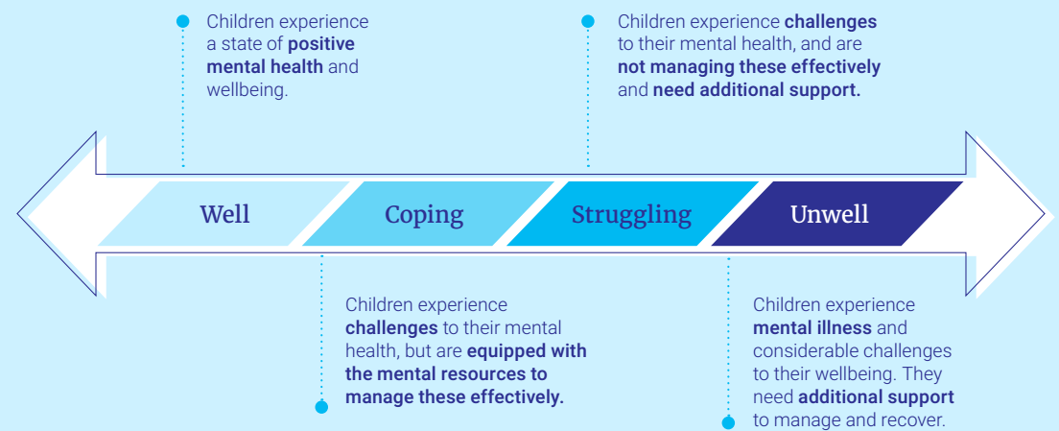
Results …(2/3)
National Mental Health Commission (2021)
APHI-FHEIA 4th Joint International Annual Research Conference

Slide 10
Results …(3/3)
The intervention results revealed that the experimental group scored statistically significant higher mean score than control group.
 There is no significant gender and school type (government/private) difference on children’s resilience skills before and after intervention.
Changes in Children’s Resilience Scores across the Experimental and Control Groups
Variable | Experimental Group (N = 104) |  | Control Group (N = 101) |  | df | t | Sig.
 | M | SD | M | SD
Pre-intervention Score | 27.11 | 4.68 | 28.19 | 4.86 | 203 | -1.62 | .11
Post-intervention Score | 29.86 | 4.22 | 28.08 | 4.95 | 203 | 2.77 | .01
APHI-FHEIA 4th Joint International Annual Research Conference

Slide 11
Conclusions and Recommendations…(1/1)
Majority of children experience mild to moderate mental health problems including depression, anxiety and stress.
School-based mental health intervention constituting soft skills trainings on self-discovery, mind set development, self-efficacy, emotion regulation, problem solving, and social skills significantly increase the resilience of children.
Thus, it is recommended that:
- Professionals, education offices and organizations working on children should design strategies to strengthen school-based interventions aiming enhance resilience of children.
- Schools should allocate time for resilience-enhancing intervention programs either by integrating in the regular classes or providing it in the weekends aiming to boost children’s psychological strength.
APHI-FHEIA 4th Joint International Annual Research Conference

Slide 12
Acknowledgements
University of Gondar
School directors and unit leaders
Research participants
Amhara Public Health Institute
APHI-FHEIA 4th Joint International Annual Research Conference

Slide 13

THANK YOU

