Slide 1
Exploring the Lived Experiences and Coping Strategies of Mental Health Caregivers in Gondar Ethiopia: Implications for Supportive Intervention
Author(s): Shegaye Shumet, Ejigu Gebeye
Affiliation (s): CMHS, University of Gondar
Conference Theme: Translating Research into Action: Strengthening Public Health Systems in Crisis-Affected Settings
Amhara Public Health Institute - Forum for Higher Education Institutions in the Amhara Region 4th Joint International Annual Research Conference
December 4-5, 2025, Bahir Dar, Ethiopia

Slide 2
Presentation outlines
Background
Objectives
Methods
Result and Discussion
Conclusion and Recommendations
Acknowledgements
APHI-FHEIA 4th Joint International Annual Research Conference

Slide 3
Background…(1/2)
Coping- the conscious effort to manage and adapt to stress, adversity, or challenging situations that exceed an individual's immediate resources (Folkman and Moskowitz, 2004).
Caregiving creates substantial physical, emotional, and financial demands, exposing caregivers to high levels of burden, chronic stress, and burnout risk (Janardhana et al., 2015; Chadda, 2014).
Caregiver coping strategies directly influence both patient outcomes and caregiver well-being (Wang et al., 2021; Mohamed et al., 2023).
Research reveals significant cultural and contextual differences in coping strategy utilization across populations (Walke et al., 2018,Kamarulbahri et al., 2022)
APHI-FHEIA 4th Joint International Annual Research Conference

Slide 4
Background…(2/2)
Key determinants: age, gender, caregiver burden, physical health status, social support availability, and exposure to disruptive patient behaviors (Thakur et al., 2022).
Impact of maladaptive Coping
Physical Health Deterioration (Wang et al., 2021; Moges et al., 2021)
Quality of Care Decline (Kazemi et al., 2021)
Despite the significant challenges faced by family caregivers in Ethiopia, there remain gaps in understanding the coping strategies they employ
So, this study aimed to assess explore lived experiences, coping strategies and determinants among family caregivers at UoG CSH, north west Ethiopia.
APHI-FHEIA 4th Joint International Annual Research Conference

Slide 5
Objectives …(1/1)
General objective
To explore lived experiences, assess coping strategy to stress and its determinants among family care givers of people with mental illness at University of Gondar Comprehensive and specialized Hospital, northwest Ethiopia, 2024.
Specific objectives
To assess coping strategy of family care givers of people with mental illness
To identify determinants for coping strategy among family care givers of people with mental illness
To explore lived experience of family care givers of people with mental illness
APHI-FHEIA 4th Joint International Annual Research Conference

Slide 6
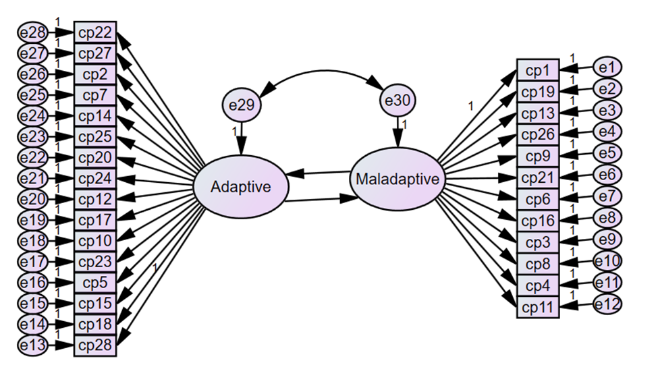

Methods …(1/2)
Design | Settings and period | Population | sampling | Variables | Data collection tools
Parallel mixed method approach | UOG CSH Jun and July, 2024 | All family care givers during data collection time | Parametre N:q rule(10:1) (Er=30, Cov=1, path coef=28, 5% NR=>n=620) SRS (K=2) , Purposive sampling | DV=coping (adaptive and maladaptive) as continous IV=Sociodemographic and clinical variables | Brief COPE OSS RSS Kessler-10 Indepth interview
APHI-FHEIA 4th Joint International Annual Research Conference

Slide 7
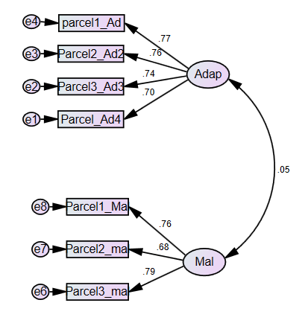
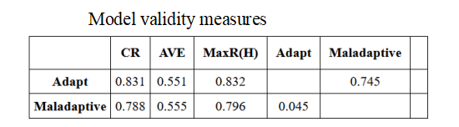
Methods …(2/2)
Measurement fit indices for measurement model after parceling
Measure | Etimate | Threshold
CMIN/DF | 2.89 | <5
GFI | 0.98 | >0.9
CFI |  | “
RMSEA | 0.057 | <0.08
SRMR | 0.04 | <0.05
BIC | 132.93.
APHI-FHEIA 4th Joint International Annual Research Conference

Slide 8
Results and Discussion …(1/3)
Mean adaptive coping: 34.65 (SD = ±7.70), with 95%CI(34.02 to 35.28) Higher 25.25(Azale et al., 2018) and low Saudi Arebia (M=43.79) (Marzban et al., 2024) Population variation Assesment tool Our qual. study supports this findings: caregivers use both coping strategies, with religious coping being the most common adaptive method Direct F/ sex (β = −0.10) older age (β = −0.07) farmer(β = −0.21) long duration of illness (β = −0.10) Indirect ( via PDD): Physical abuse-↓ adaptive coping Total effect: Number of admission (β = -0.08) | Prolonged caregiving at holy water sites leads to emotional strain, financial stress, and reduced resilience (Baheretibeb et al., 2021; 2024; Almeida et al., 2021). Women face heavier emotional burdens and multiple caregiving roles → more distress, more maladaptive coping (Martos Martínez et al., 2021). Long-term caregiving and repeated hospitalizations accumulate stress and reduce coping capacity (Dadson et al., 2018; Dagani et al., 2023). Older caregivers face declining health, reduced support, and higher distress → weaker adaptive coping (Kang & Kim, 2022; Freyhofer et al., 2021). Physical abuse increases stigma and distress → undermines adaptive coping (Ong, Ibrahim & Wahab, 2016; Mehra et al., 2020).
APHI-FHEIA 4th Joint International Annual Research Conference

Slide 9
Results and Discussion…(2/3)
-ves: all reduce maladaptive coping indirectly via ↑ adaptive coping
Comorbid medical illness intensifies emotional distress → more maladaptive coping (Cheng et al. (2022); Mihan et al. (2023); Munie et al. (2024).
Literacy reduces distress, improves problem-solving → ↓ maladaptive coping (Zhou et al. (2021); Fairfax et al. (2019).
Older age/women/farmers benefit from better social networks → more adaptive coping, less maladaptive coping (Rahmani et al. (2024); Alosaimi et al. (2018).
Frequent admissions may enhance caregiver knowledge and resilience → indirectly ↓ maladaptive coping.
Burden and distress strongly predict maladaptive coping, while social support is a key protective factor (Menefee et al. (2022);Amini et al. (2023)).
Qualitative themes confirm: physical abuse, relapse, and financial strain heighten emotional exhaustion and push caregivers toward avoidance, withdrawal, and disengagement.
Maladaptive: 21.10 (SD = ±5.00) with 95%CI (20.69 to 21.51)
Higher (18.30) Iran (Owen et al., 2023)
In our study, high stress from frequent hospitalizations and symptom relapse led to maladaptive coping like withdrawal and avoidance.
Direct: Psychological distress (β = 0.13)
Indirect: F/sex(β=-0.05,), age (β=-0.04), able to read and write(β=0.01), JL+,Verbal & physical abuse (β = 0.07&0.01), duration of illness(β=-0.06), number of admission(β=-0.04), Symptom relapse(β = 0.08), Hx of hospitalization (β = 0.04), SS (β=-0.09)
Total effect: Burden (β = 0.45),Commorbid medical illness(β =0.25)
PHI-FHEIA 4th Joint International Annual Research Conference

Slide 10
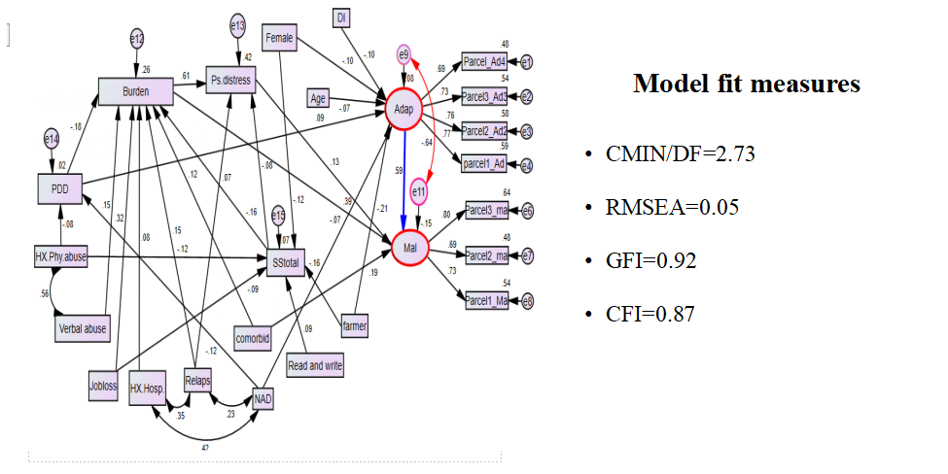
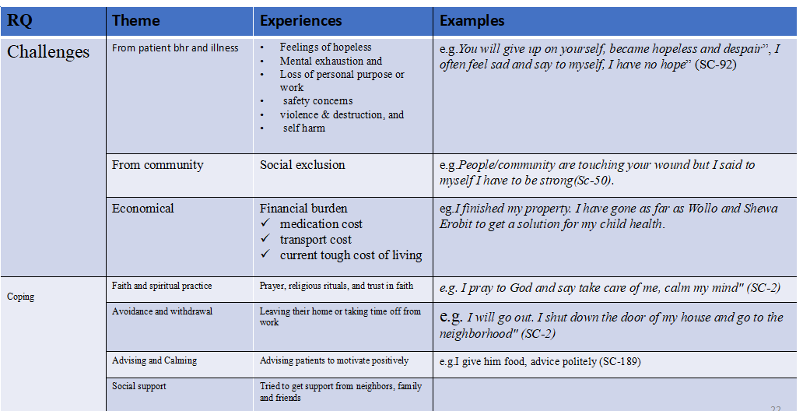
Results and Discussion …(3/3)

Slide 11
Conclusion and Recommendations …(1/2)
Family caregivers were having low adaptive coping compared to general population.
Caregivers used both adaptive and maladaptive coping.
Being a farmer, female, age, and long duration of illness, higher number of admissions have an effect with adaptive coping
Comorbid medical illnesses, caregivers' literacy levels, being a farmer, female, age, duration of the patient's illness, and the number of hospital admissions, history of physical abuse, job loss due to caregiving, symptom relapse, and previous hospitalization have an effect on maladaptive coping .
Furthermore, caregiving burden and psychological distress have a direct positive effect on maladaptive coping, while social support has a direct negative effect on maladaptive coping.
APHI-FHEIA 4th Joint International Annual Research Conference

Slide 12
Conclusion and Recommendations …(2/2)
For Health Care Professionals:
Provide psychological support to caregivers, especially those facing symptom relapses or abuse.
Address stigma in early stages of illness to promote adaptive coping.
For Ministry of Health:
Implement preventive mental health programs to strengthen caregivers’ coping strategies alongside patient care.
For Researchers:
Conduct longitudinal studies to examine how clinical factors influence caregivers’ mental health and coping over time.
APHI-FHEIA 4th Joint International Annual Research Conference

Slide 13
Acknowledgement
Study participants
Data collectors
University of Gondar
Mr. Ejigu Gebeye
APHI-FHEIA 4th Joint International Annual Research Conference

Slide 14

THANK YOU

