Slide 1
Can Ethiopia Achieve HSTP-II and SDG targets of Neonatal Mortality? Application of classical techniques and deep-learning models for time-series forecasting.
Shimels Derso Kebede (MPH)
Lecturer, Department of Health Informatics, CMHS, Wollo University
Conference Theme: Translating Research into Action: Strengthening Public Health Systems in Crisis-Affected Settings
Amhara Public Health Institute - Forum for Higher Education Institutions in the Amhara Region 4th Joint International Annual Research Conference
December 4-5, 2025, Bahir Dar, Ethiopia

Slide 2
Background
Neonatal mortality serves as a significant indicator of healthcare system responsiveness
In Ethiopia, a lower decline, 41%, was observed in neonatal mortality
compared to the 60% reduction in under-five mortality
and 50% reduction in infant mortality between 2000 and 2016 (Central Statistical Agency (CSA) [Ethiopia] and ICF, 2016).
Ethiopia aims to reduce neonatal mortality to 21 per 1,000 live births by 2025(HSTP-II) and
to 12 or fewer per 1,000 live births by 2030(SDG goal).
This study aims to analyze whether Ethiopia is on track to meet its national and international targets by forecasting neonatal mortality rate.

Slide 3
Methods (1/4)
The data sourced from the World Bank databank (databank.worldbank.org), providing annual neonatal mortality rates for Ethiopia from 1990 to 2020
from classical time-series models (python statsmodels package)
autoregressive integrated moving average (ARIMA)
double exponential smoothing
deep-learning algorithms (from keras framework in python)
convolutional neural networks (CNN)
long short-term memory(LSTM)
multilayer perceptron (MLP) to forecast the neonatal mortality rate from 2021 to 2030.
Notes:
URL: https://databank.worldbank.org/source/health-nutrition-and-population-statistics
https://childmortality.org/all-cause-mortality/analysis/trends?refArea=ETH&indicator=MRY0

Slide 4
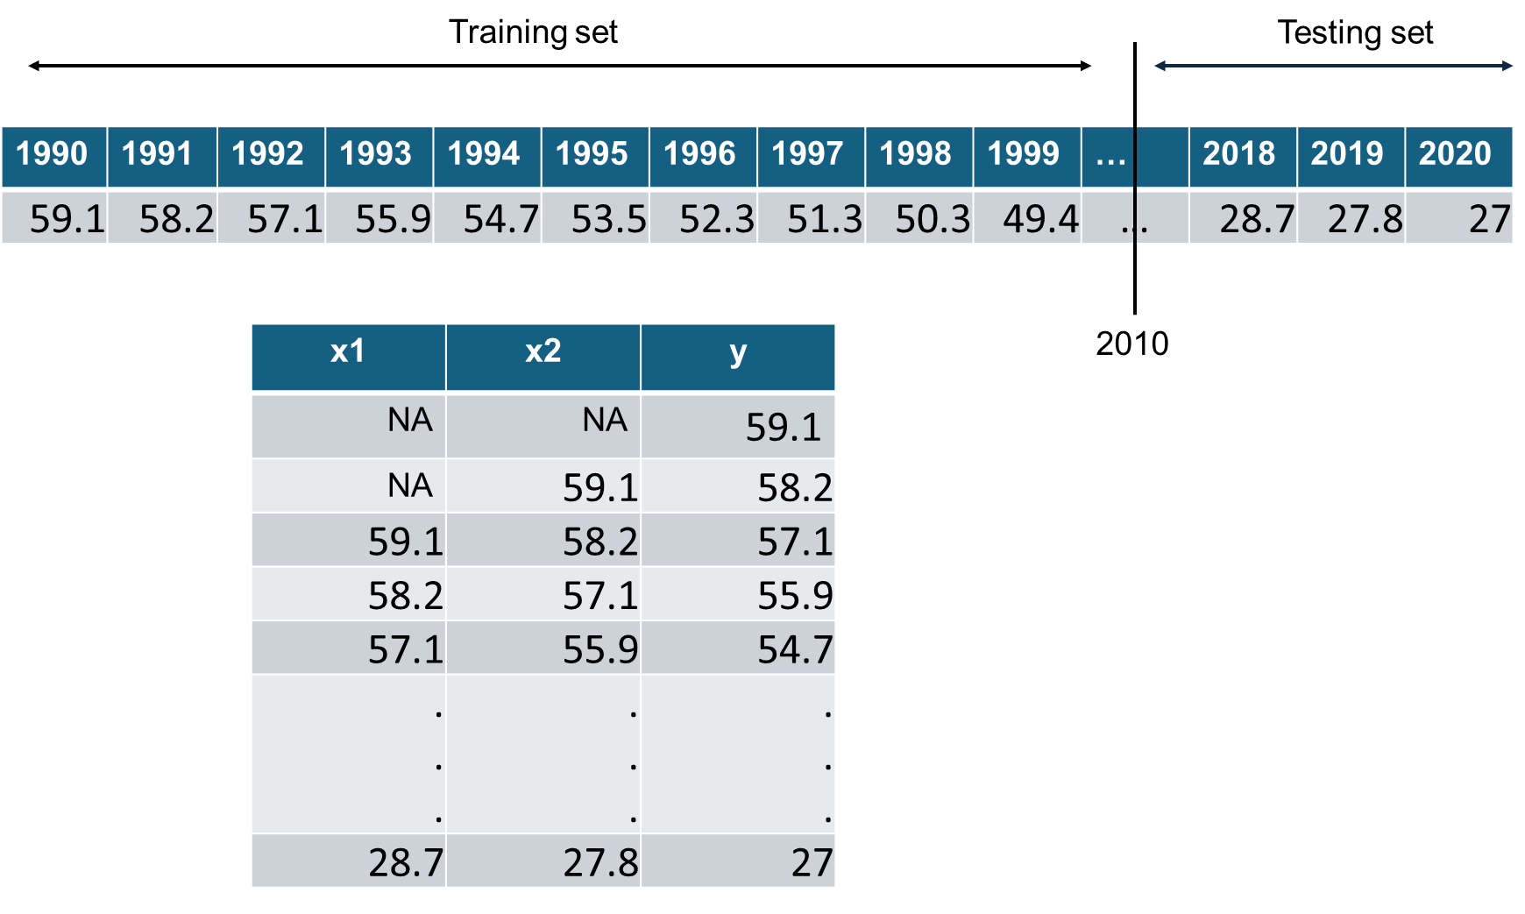
Methods (2/4)
Unlike the standard train test split technique, which randomly splits the data, the temporality of the dataset should be maintained in time-series data partitioning.

Slide 5
Methods (3/4)
Time-series forecasting models can be evaluated on a test set using walk-forward validation, an approach in which the model makes a forecast for each observation in the test set, one at a time.
Using this forecasting approach, ten years NMR (from 2011 to 2020) was predicted, the predictions were compared to the true values in the test set, and an error measure was calculated.
R², root mean squared error (RMSE), and mean absolute percentage error(MAPE), were used to evaluate the predictive performance
Accordingly, the model that maximizes R² or minimizes RMSE or MAPE was selected as the best model.
Finally, the best model used to forecast the neonatal mortality rate for the next 10 years, from 2021 to 2030, with a 95% prediction interval (PI)

Slide 6
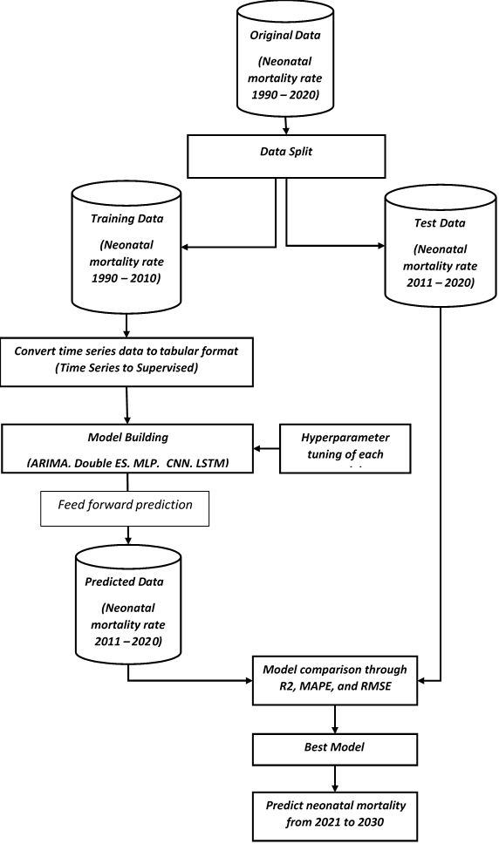
Methods (4/4)
Figure: Workflow of data preparation and analysis plan to forecast neonatal mortality in Ethiopia.

Slide 7
Result and discussion (1/5) : Model evaluation
The performance of the fitted models on the test data presented in Table
Accordingly, double exponential smoothing model was the best, with a maximum R² of 99.94% and minimum MAPE and RMSE of 0.0015 and 0.0748, respectively.
The worst performing among all was the CNN, with an R² of 93.71% and a maximum RMSE of 0.7903.
These findings suggest that while deep learning models have potential, they may not yet surpass classical methods in this context.
The Double Exponential Smoothing model slightly outperformed ARIMA, with an R2 of 99.94% and a MAPE of 0.0015, making it the best-performing classical model.
Model | R² | MAPE | RMSE
Double Exponential Smoothing | 0.9994 | 0.0015 | 0.0748
ARIMA | 0.9992 | 0.0025 | 0.0864
MLP | 0.9884 | 0.0094 | 0.3396
LSTM | 0.9830 | 0.0116 | 0.4110
CNN | 0.9371 | 0.0237 | 0.7903

Slide 8
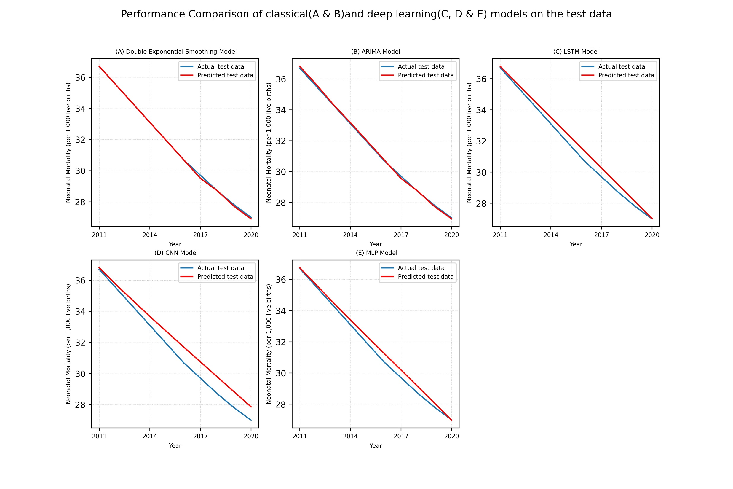
Result and discussion (2/5) : Model evaluation
The performance of all models is clearly observed graphically, with an overlap of the predicted and actual data in double exponential smoothing and a relatively large gap in the CNN model

Slide 9
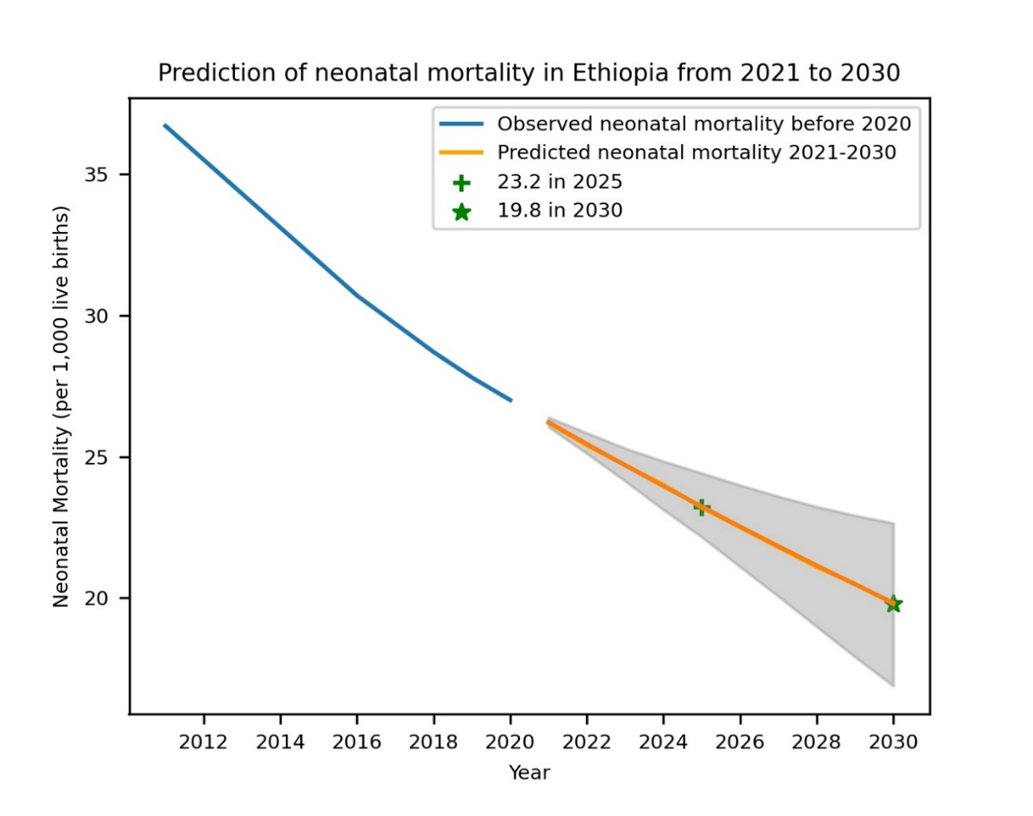
Result and discussion (3/5) : Final Forecasting
Neonatal mortality was predicted from 2021 to 2030 using a double exponential smoothing model with a 95% prediction
Accordingly, neonatal mortality in Ethiopia was forecasted to be 23.2 (PI: 22.2, 24.4) per 1000 live births in 2025 and 19.8 (PI: 17.1, 22.8) per 1000 live births in 2030.
From this estimation, it is clear that Ethiopia is slightly below the HSTP-II neonatal mortality rate target of 21 per 1000 livebirths by 2025
and is also highly unlikely to meet the SDG target of 12 or fewer neonatal deaths per 1000 live births by 2030.

Slide 10
Result and discussion (4/5)
Contrary to common assumptions, classical time-series models like ARIMA and Exponential Smoothing outperformed advanced deep learning models in this context.
This suggests that simpler, well-established methods may sometimes be more effective than complex ones, particularly when data is limited.
The results also revealed Ethiopia’s inability to achieve the SDG of reducing neonatal mortality,
possibly due to the Covid-19 pandemic and armed conflict that occurred since 2019 which jeopardised the healthcare system and made it difficult for women to receive prenatal and postnatal care due to lockdowns and restrictions, which in turn created vulnerable populations, exposing expectant mothers and new-borns to danger.

Slide 11
Result and discussion (5/5)
Furthermore, ongoing conflict in some areas of Ethiopia forced some healthcare facilities to be non-operational or services interruption, which consequently makes it difficult to achieve the SDG.
The findings emphasize the importance of addressing the gaps in Ethiopia's healthcare system, as these could impede progress towards reducing neonatal mortality.
To meet the SDG and HSTP-II targets, there is a clear need for targeted policy interventions that enhance neonatal care.

Slide 12
Limitations
While this study provides valuable insights into neonatal mortality forecasting, it is essential to acknowledge its limitations.
The data used is limited, spanning only from 1990 to 2020, may not capture all the variability needed for accurate long-term forecasting.
Additionally, the models employed in this study didn’t incorporate potential covariates that could provide a more nuanced understanding of the factors influencing neonatal mortality
External factors, including socio-political challenges like conflicts and pandemics, also play a significant role in influencing neonatal mortality rates, potentially limiting the models' predictive accuracy.

Slide 13
Conclusions
This study revealed that the national (HSTP-II) and international (SDG) targets for neonatal mortality cannot be realized if the current trend continues.
This highlights that urgent interventions are necessary to strengthen the healthcare system and accelerate the decline of neonatal mortality rate.
To achieve these targets, collaborative efforts with concerned stakeholders are also needed to improve the healthcare system and provide responsive neonatal and child health services.

Slide 14
Recommendations (1/2)
Looking forward, future research should aim to build on the findings of this study by incorporating larger and more diverse datasets.
This will help to improve the robustness and accuracy of predictive models.
Furthermore, it is crucial to consider socio-political factors, such as conflicts and policy changes, which can significantly impact neonatal mortality trends.
Integrating these variables and other potential covariates into forecasting models could lead to a more comprehensive understanding of the factors influencing neonatal health outcomes.

Slide 15
Recommendations (2/2)
The government is encouraged to focus on improving healthcare infrastructure that includes increasing access to quality perinatal and postnatal care, equip health facilities with necessary resources, and train health care provides to deliver effective neonatal care.
In light of the challenge posed by armed conflicts and internal displacement humanitarian aid organizations and stakeholders are urged to ensure that maternal and neonatal health services are prioritized in conflict affected areas and other humanitarian settings.

Slide 16



Thank you!
+251 940 21 98 18
Shimels.derso@wu.edu.et / shime4d@gmail.com
https://shimelsd.netlify.app

Slide 17
Annex I : Results of model hyperparameter tuning.
Model | Model Hyper parameters | Hyper parameter space | Total combination | Best combination
ARIMA | p, d, q | p = [0,1,2,3,4] d = [0,1,2,3] q= [0,1,2,3] | 80 | p=2,d=1,q=2
Double Exponential Smoothing | trend, damped | trend=[‘add’, ‘mul’] damped = [True, False] | 4 | trend= 'add' damped= True
MLP | n_input, n_nodes, n_batch, n_diff | n_input = [2,3,4,5] n_nodes = [100, 150] n_batch = [1, 150] n_diff = [0,1, 2,4] | 64 | n_input = 4, n_nodes =100, n_batch=1, n_diff = 1
LSTM | n_input, n_nodes, n_batch, n_diff | n_input = [2,3,4,5] n_nodes = [100, 150] n_batch = [1, 150] n_diff = [0,1, 2,4] | 64 | n_input = 4, n_nodes =100, n_batch=1, n_diff = 1
CNN | n_input, n_diff | n_input = [2,3,4,5] n_diff = [0,1, 2,4] | 16 | n_input = 4, n_diff = 1
Notes:
ARIMA: p: Number of past values (lags) used. d: Number of differences needed to make the series stationary. q: Number of past errors used to minimize forecasting error.

Slide 18
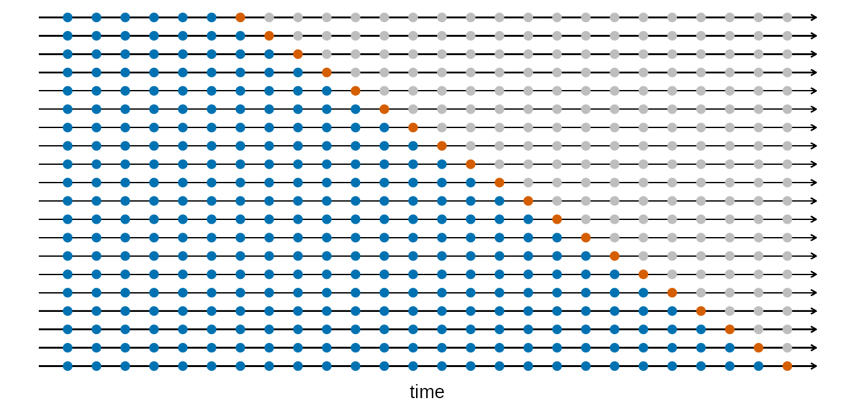
Annex II : feed-forward validation.
Source: Hyndman, R.J., & Athanasopoulos, G. (2021) Forecasting: principles and practice, 3rd edition

