Slide 1
Effect of ADHERE eHealth intervention on adherence to quality improvement tools in intrapartum care: Implementation research in Ethiopia
Dabere Nigatu, Muluken Azage Yenesew, Eyaya Misgan, Daniel A. Enquobahrie, Tegegn Kebebaw, Enyew Abate, Esubalew Alemneh, Mirkuzie Woldie, Tsinuel Girma
Conference Theme: Translating Research into Action: Strengthening Public Health Systems in Crisis-Affected Settings
Amhara Public Health Institute - Forum for Higher Education Institutions in the Amhara Region 4th Joint International Annual Research Conference
December 4-5, 2025, Bahir Dar, Ethiopia

Slide 2
Presentation outlines
Background
Objectives
Methods
Result and Discussion
Conclusion and Recommendations
Acknowledgements
APHI-FHEIA 4th Joint International Annual Research Conference

Slide 3
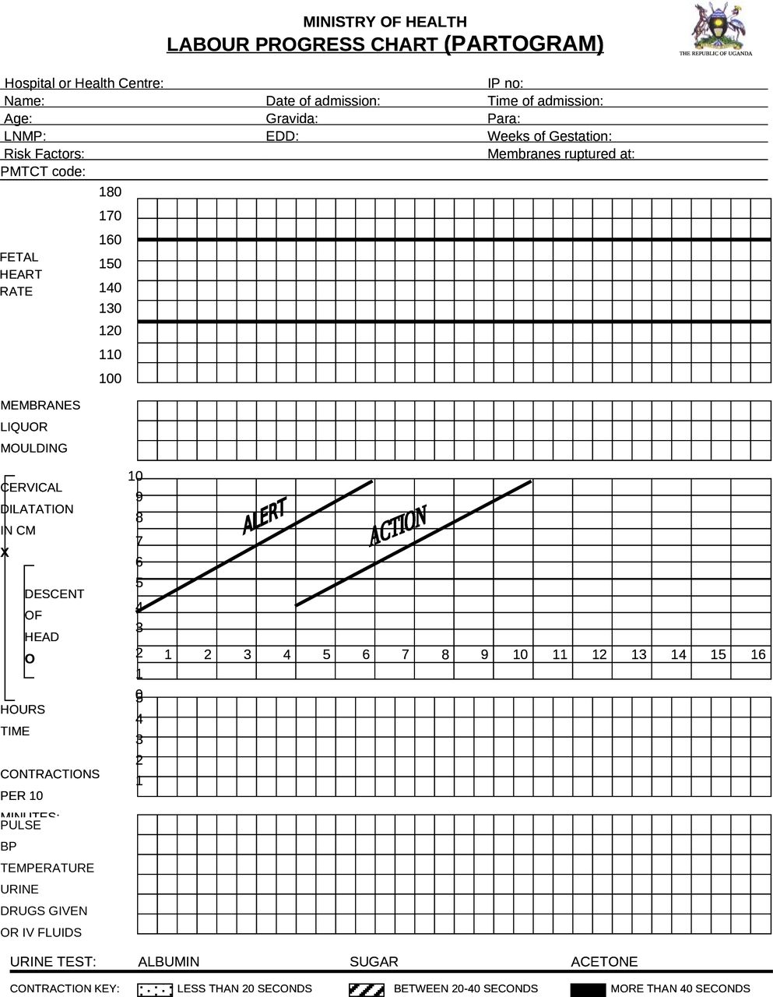
Background…(1/2)
Partograph and Safe Childbirth Checklist (SCC) – QI tools
  WHO – 1980s vs 2015 (WHO 1995, WHO 2015)
  37.3% reduction in perinatal mortality rates (Kabongo et al 2017)
In Ethiopia & other LMICs, poor quality of care:
  Total partograph non-use: 40% – 45% (Ayenew et al., 2020, Ayele et al 2025).
  substandard adherence to partograph were common (Negash & Alelgn, 2021)
  Failure to complete the WHO SCC in a typical birth: 60% (Semrau et al 2017)
ePartograph:
Automatically draw graphs
Avoid retrospective filling
Give measurement due
List suggested interventions
eCDS – one promising eHealth interventions to enhancing quality of care in LMICs (Neumann et al., 2021, Erku et al., 2023).
Thus, we developed an eHealth innovation – ADHERE system (eMCH tool) and deployed it at POC in public health facilities.
APHI-FHEIA 4th Joint International Annual Research Conference

Slide 4
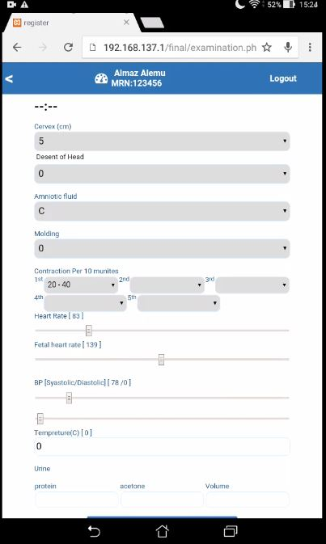
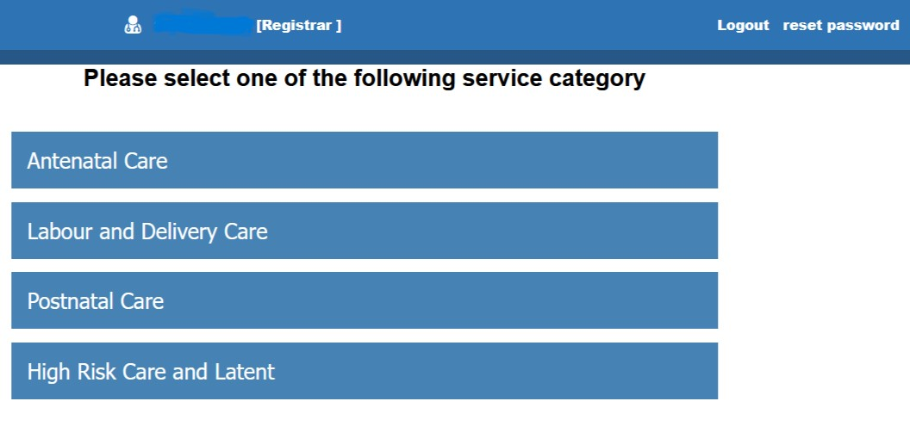
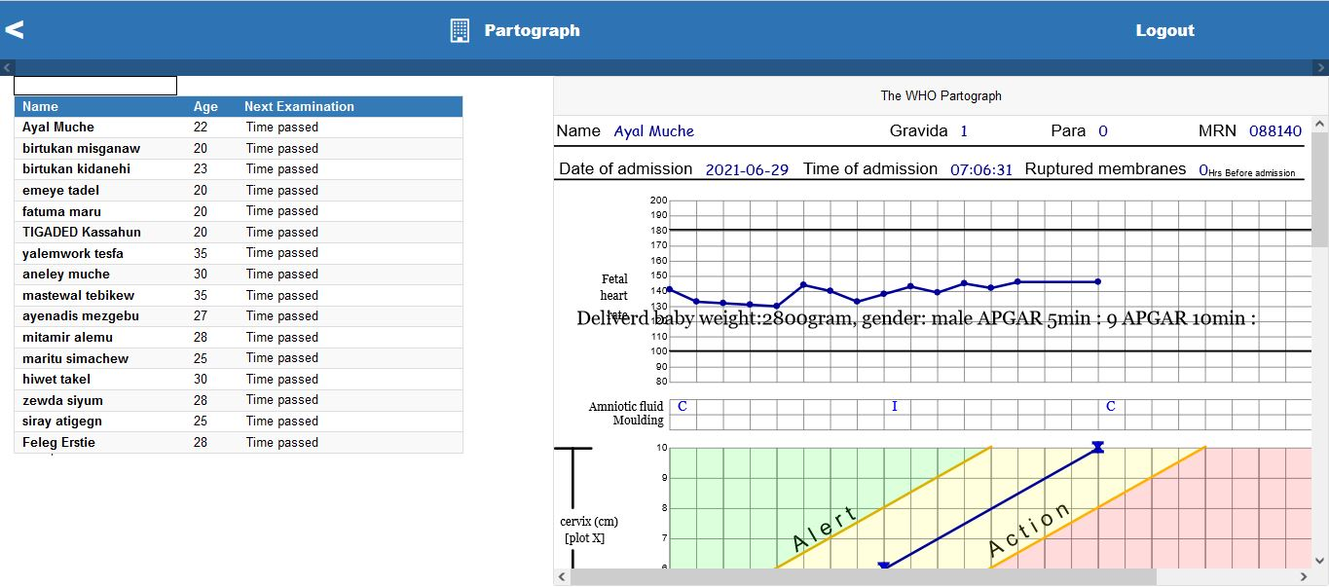
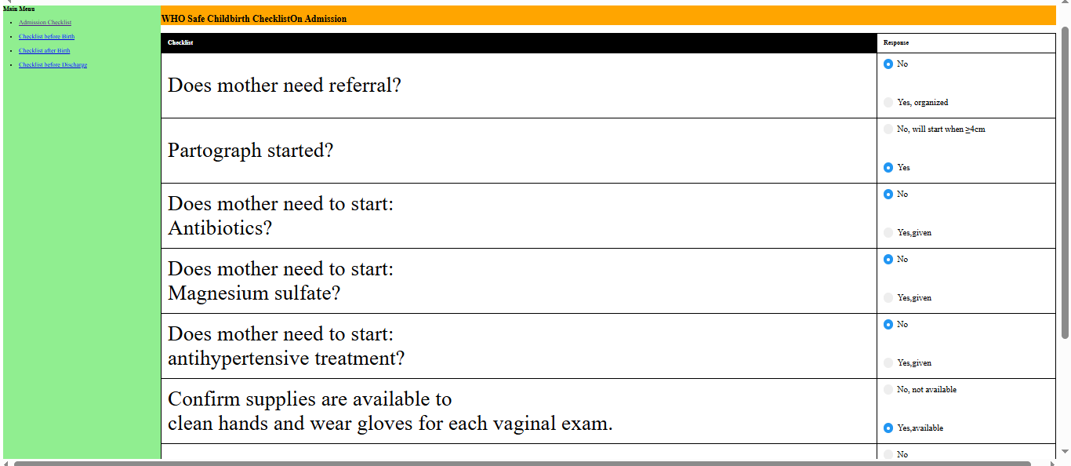
Background…(2/2)
Demo
APHI-FHEIA 4th Joint International Annual Research Conference

Slide 5
Objectives …(1/1)
To examine the effect of ADHERE eHealth interventions on adherence to labor and delivery care in public health facilities
APHI-FHEIA 4th Joint International Annual Research Conference

Slide 6
Methods …(1/2)
Study setting: 9 HFs (5 intervention and 4 control)
Study design: Quasi-experimental design (QED)
  a pre- and post-design with a non-equivalent control group
Hybrid effectiveness-implementation design
  Hybrid type 3 design
Sample size: 1076 (538 per groups)
  2152 (Baseline +Endline)
Data collection: review of L&D charts – Survey checklist
  Trained midwives collected the data via tablet computers
  Epicollect5 software
Data analysis: Difference-in-Differences (DiD)
Study intervention
ADHERE-based intrapartum care - QI
Frontline health workers at a POC care
eCDS to enhance providers decision
APHI-FHEIA 4th Joint International Annual Research Conference

Slide 7
Implementation process of ADHERE intervention
Establishing research team or working group
Setting core research objectives
Identify and consulting of stakeholders
Rapid review and formative assessments
Usability testing of ADHERE tool
Preparation of ADHERE tool user manual
MOH
RHB
Health facilities
Health care provider
Phase-1: Pre-intervention
(Sept 2021- April 2022)
ADHERE based-intervention health facilities
Control health facilities
Baseline survey
Availing devices e.g., tablets, access points
Prepare training manuals and training of key implementers
Execution of ADHERE interventions
Supportive supervision
Performance review meetings
Receive the usual care
Phase-2: Intervention (May 2022-April 2023)
Primary outcomes evaluation
Adherence to ANC
Adherence to L&D
Activities:
Endline survey
Data analysis
Report writing
Secondary outcome evaluation
Adverse birth outcomes
Activities:
Endline survey
Data analysis
Report writing
Phase-3: Evaluation (May 2023 - Dec 2024)

Slide 8
Methods …(2/2)
Adherence to L&D QI tools
Two categories of outcome related to adherence to intrapartum QI tools:
  adherence to partograph
  adherence to WHO SCC
Adherence to partograph
measured by partograph indices
9 indices
Score 0 to 9
Adherence to WHO SCC: 4 subtypes
On-admission: 8 EBPs
Before childbirth: 6 EBPs
After childbirth: 9 EBPs
On-discharge: 8 EBPs
  All or none
APHI-FHEIA 4th Joint International Annual Research Conference

Slide 9
Results and Discussion …(1/3)
Effect of ADHERE intervention on partograph adherence score
Outcomes | Time |  | Difference | Simple DiD (95% CI) | Adjusted DiD (95% CI)
 | Pre | Post
Mean score
Control | 4.11 | 4.14 | 0.03 | 4.21 [1.71, 5.10] | 4.27 [1.80, 5.09]
Intervention | 4.23 | 8.47 | 4.24
A quasi-experimental study in Kenya:
Greater adherence to intrapartum care – ePartograph than the paper-partograph
CDS intervention in the ePartograph (Sanghvi et al., 2019)
A cross-over study done in Bangladesh:
partograph use rate improved in ePartograph
  38% vs 21.3% on 1st phase
  38% vs 2.8% on 2nd phase (Rahman et al., 2019)
APHI-FHEIA 4th Joint International Annual Research Conference

Slide 10
Results and Discussion…(2/3)
Effect of ADHERE intervention on adherence to WHO SCC subtype
Outcomes | Time |  | Difference | Simple DiD (95% CI) | Adjusted DiD (95% CI)
 | Pre | Post
Admission checklist
Control | 0.025 | 0.025 | 0.000 | 0.135 [0.072, 0.198] | 0.093 [0.036, 0.151]*
Intervention | 0.487 | 0.622 | 0.135
Before-birth checklist
Control | 0.024 | 0.025 | 0.001 | 0.342 [0.252, 0.431] | 0.223 [0.121, 0.325]*
Intervention | 0.400 | 0.742 | 0.342
After-birth checklist
Control | 0.019 | 0.020 | 0.001 | 0.247 [0.184, 0.309] | 0.152 [0.072, 0.231]*
Intervention | 0.386 | 0.632 | 0.246
Discharge checklist
Control | 0.018 | 0.017 | -0.001 | -0.044 [-0.107, 0.019] | -0.025 [-0.071, 0.021]
Intervention | 0.460 | 0.415 | -0.045
APHI-FHEIA 4th Joint International Annual Research Conference

Slide 11
Results and Discussion …(3/3)
Earlier studies in Africa indicated that QI interventions led to improved adherence to WHO SCC:
In India, CRCT – a coaching-based SCC:
  Average adherence increased by 24 ppts
  admission (84% to 98%)
  before birth (66% to 94%)
  immediately after birth (75% to 95%),
  discharge (90% to 99%)
In Turkey,
  the eCDS system significantly improved proper use rate of the WHO SCC – 61% to 97.4%
(Marx Delaney et al., 2017, Özkan and Acar, 2025)
In Namibia, SCC led by a facility champion,
  increased the average EBPs delivered from 68% to 95%
A multi-country study (Kenya & Uganda):
  In Kenya, SCC completion was >70% for all pause points
  In Uganda, it ranges from 39% to 75%.
  intervention facilities demonstrated higher completion rates than control sites (Kabongo et al., 2017, Achola et al., 2022)
APHI-FHEIA 4th Joint International Annual Research Conference

Slide 12
Conclusion and Recommendations …(1/2)
The ADHERE intervention significantly improved adherence to partograph and WHO SCC subtype, except for the discharge checklist.
The system could be considered for broader implementation across health facilities.
  However, the scale up should consider the strategies used to overcome the implementation challenges.
  Use of IR models or frameworks is also equally important
    Adapted IRLM
    FRAME-IS framework
APHI-FHEIA 4th Joint International Annual Research Conference

Slide 13
Conclusion and Recommendations …(2/2)
Health practitioners should recognize the importance and use the ADHERE system
Future research focus:
  Direct observations during L&D care provision – partograph and WHO SCC
  Strong designs like Cluster RCT
  Feasibility and acceptability of scale-up of the ADHERE system
    interoperability issues and multiplicity of electronic platforms used at the point-of-care in Ethiopia.
APHI-FHEIA 4th Joint International Annual Research Conference

Slide 14
Acknowledgement
PhD Supervisors:
  Dr. Muluken A, Prof. Tsinuel G, Dr. Eyaya M, & Prof. Daniel E
ADHERE research team
BDU-CMHS, APHI and Fenot Project:
  Funding the project
Study participants:
  HCPs, Health facilities, and Health system managers
Event organizers: APHI and FHEIA
APHI-FHEIA 4th Joint International Annual Research Conference

Slide 15

THANK YOU

