Slide 1
Health system responsiveness and its associated factors for intrapartum care in conflict affected settings in Amhara region, Ethiopia.
        Dr. Asmamaw Atnafu, Wubshet Debebe¹, Tsegaye Haile¹, Melaku Birhanu¹, Endalkachew Dellie¹, Dr. Adane Kebede¹, Jinha Park², Selamawit Tefera², and Biruhtesfa Mouhabaw¹
        ¹University of Gondar, Gondar, Ethiopia, ²KOFIH Ethiopia Health Office
Conference Theme: Translating Research into Action: Strengthening Public Health Systems in Crisis-Affected Settings
Amhara Public Health Institute - Forum for Higher Education Institutions in the Amhara Region 4th Joint International Annual Research Conference
December 4-5, 2025, Bahir Dar, Ethiopia

Slide 2
Presentation outlines
Background
Objectives
Methods
Result and Discussion
Conclusion and Recommendations
Acknowledgements
APHI-FHEIA 4th Joint International Annual Research Conference

Slide 3
Background…(1/2)
Health system responsiveness is how well the health system meets the legitimate
expectations of the population for the non-health enhancing aspects of the health
system (WHO,2003)
HSR is operationalized into eight domains (WHO, 2003)
Dignity Prompt attention
Autonomy Choice providers/ facility
Confidentiality Access to social support
Communication
APHI-FHEIA 4th Joint International Annual Research Conference

Slide 4
Background…(2/2)
For understanding non-clinical enhancing aspects of health systems, measuring health care responsiveness is mandatory (De Silva A, Valentine N,2000)
The study helps to identify health system shortcomings, protect patient rights to timely care, and improve responses to mothers’ expectations (De Silva A, 2000, Gesesew H. 2021).
The results of this study can also be beneficial for policymakers and non-governmental organizations to respond to existing health needs of the women and to enhance the health system in conflict-affected settings.
APHI-FHEIA 4th Joint International Annual Research Conference

Slide 5
Objectives …(1/1)
General objective
To assess health system responsiveness and associated factors for intrapartum care in conflict affected areas in Amhara region, Ethiopia.
Specific objectives
To determine health system responsiveness for intrapartum care in conflict affected areas in Amhara region, Ethiopia.
To identify factors associated with health system responsiveness for intrapartum care in conflict affected areas in Amhara region, Ethiopia.
APHI-FHEIA 4th Joint International Annual Research Conference

Slide 6
Methods …(1/2)
Study design
Community-based cross-sectional
Study areas
Conflict affected areas in Amhara region (Wadila, Meket and Gaynt districts)
Population
Women who gave birth in conflict-affected areas within the last six months at health facilities. Excluded those who delivered at home.
APHI-FHEIA 4th Joint International Annual Research Conference

Slide 7
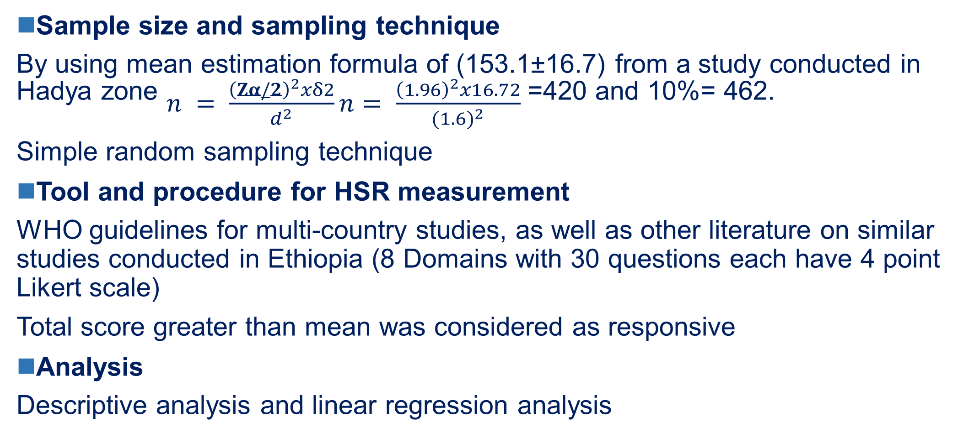
Methods …(2/2)
Sample size and sampling technique
By using mean estimation formula of (153.1±16.7) from a study conducted in Hadya zone $n = \frac{{\left(Zα/2\right)}^{2}xδ2}{d^{2}}n= \frac{{\left(1.96\right)}^{2}x16.72}{{(1.6)}^{2}}$ =420 and 10%= 462.
Simple random sampling technique
Tool and procedure for HSR measurement
WHO guidelines for multi-country studies, as well as other literature on similar studies conducted in Ethiopia (8 Domains with 30 questions each have 4 point Likert scale)
Total score greater than mean was considered as responsive
Analysis
Descriptive analysis and linear regression analysis
APHI-FHEIA 4th Joint International Annual Research Conference

Slide 8
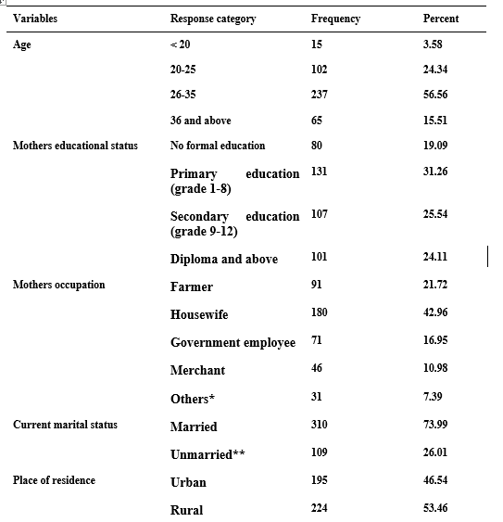
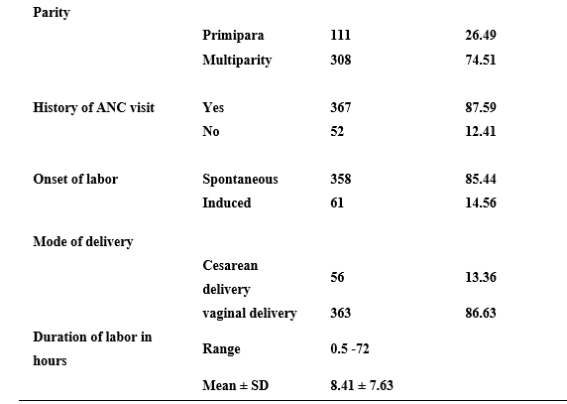
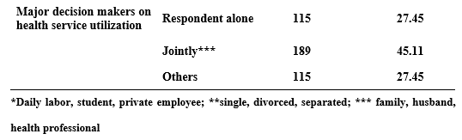
Results and Discussion …(1/3)
APHI-FHEIA 4th Joint International Annual Research Conference

Slide 9
Results and Discussion…(2/3)
The overall proportion of health system responsiveness in intrapartum care was 45.11% (95% CI: 40.38 - 49.92).
APHI-FHEIA 4th Joint International Annual Research Conference

Slide 10
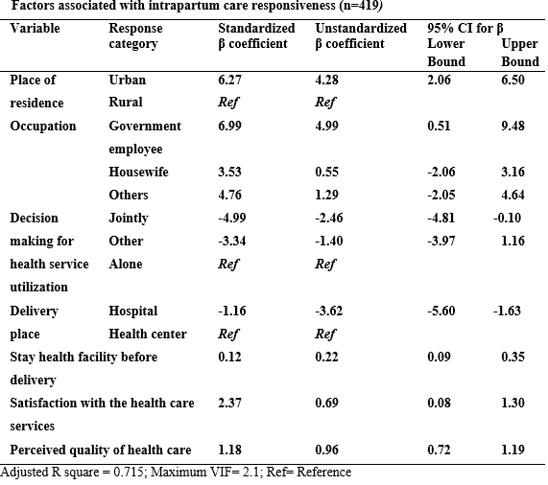
Results and Discussion …(3/3)
    Urban residence
    Government employees
    Hospital stay before delivery
    Perceived satisfaction
    Perceived quality positive association with HSR
    In contrast
    Hospital delivery
    Joint decision-making

Slide 11
Conclusion and Recommendations …(1/2)
More than half of the mothers who gave birth rated the health facilities where they received care as unresponsive.
The finding is lower than the results of previous studies conducted in Ethiopia
APHI-FHEIA 4th Joint International Annual Research Conference

Slide 12
Conclusion and Recommendations …(2/2)
We recommend
National government and non-governmental partners carefully fulfill women’s expectation of the health system in conflict-affected areas.
Special attention should also be given to the autonomy and choice domain, as well as strengthening positive patient-physician interactions.
Empowering rural resident women to make health care decisions independently is also crucial.
APHI-FHEIA 4th Joint International Annual Research Conference

Slide 13
Acknowledgements
Study participants
Korean Foundation for International Healthcare (KOFIH)…financial and medical equipment support
APHI-FHEIA 4th Joint International Annual Research Conference

Slide 14

THANK YOU

