Slide 1
Validation of a predictive nomogram for mortality among neonates with necrotizing enterocolitis in tertiary care hospitals in Bahir Dar city
Belaynew Zemed (BZA),
Zelalem Anteneh (ZAA)*
Affiliation (s)
Departments of Epidemiology and Biostatics, Bahir Dar University
Conference Theme: Translating Research into Action: Strengthening Public Health Systems in Crisis-Affected Settings
Amhara Public Health Institute - Forum for Higher Education Institutions in the Amhara Region 4th Joint International Annual Research Conference
December 4-5, 2025, Bahir Dar, Ethiopia

Slide 2
Presentation outlines
Background
Objectives
Methods
Result and Discussion
Conclusion and Recommendations
Acknowledgements
APHI-FHEIA 4th Joint International Annual Research Conference

Slide 3
Background…(1/2)
Necrotizing Enterocolitis (NEC) is Life threatening gastrointestinal disease in neonates, mainly preterm.
Pathophysiology: Ischemic necrosis of intestinal mucosa → severe inflammation → bacterial invasion → systemic sepsis & multiorgan failure.
Global: Incidence: 5–15% in neonates <1500 g, & mortality: 20–50% (Hu X, Liang H et al, 2024)
NEC in Ethiopia: Prevalence: 2–25% (Mekonnen SM et al, 2021).
Hospital Mortality: ~70% (Bimerew M, Getie A et al, 2024).
High mortality:
  Prematurity & very low birth weight
  Neonatal sepsis & perinatal asphyxia
  Delayed diagnosis & limited access to care
APHI-FHEIA 4th Joint International Annual Research Conference

Slide 4
Background…(2/2)
Knowledge Gap: Limited data on NEC outcomes & prognostic factors in Ethiopia.
Impact:
  NEC causes prolonged hospitalization, severe complications, neurodevelopmental impairment.
  High mortality (45–89%) in resource-limited settings (Matei A et al, 2020, Manohar K, et al 2023)
To develop & validate a predictive nomogram for mortality → improve risk stratification, guide clinical decisions, optimize resource allocation.
APHI-FHEIA 4th Joint International Annual Research Conference

Slide 5
Methods …(1/3)
Design: Institution-based prospective follow-up study
Period: July – December 2024
Setting: Felege-Hiwot Comprehensive Specialized Hospital (FHCSH) & Tibebe Ghion Comprehensive Specialized Hospital (TGSH).
Domain: Neonates (0–28 days) diagnosed with NEC (Stage II & III)
Exclusions:
  Stage I NEC
  Major congenital GIT anomalies
  Death unrelated to NEC
APHI-FHEIA 4th Joint International Annual Research Conference

Slide 6
Methods …(2/3)
Sample Size & Sampling
Final sample: 251 neonates (FHCSH: 104 & TGSH: 147 cases)
Sampling: Consecutive proportional allocation
Tools: Structured questionnaire + medical chart review
Predictors: 19 candidate variables
Prognostic determinates:
  Demographic & perinatal factors
  Clinical characteristics (GA, birth weight, NEC stage, etc.)
  Hematologic parameters
  Treatment-related factors
APHI-FHEIA 4th Joint International Annual Research Conference

Slide 7
Methods …(3/3)
Data Analysis & Model Development
Software: EpiData 4.6 → R 4.4.2
Steps:
  Descriptive analysis
  Bivariate (p<0.2) → Multivariate logistic regression
  Backward stepwise selection
Model Performance:
  Discrimination: AUC/ROC
  Calibration: Hosmer–Lemeshow, calibration plot
  Validation: Bootstrapping (1000 resamples)
Nomogram Construction: Based on final reduced model
Clinical Utility: Decision Curve Analysis (DCA)
APHI-FHEIA 4th Joint International Annual Research Conference

Slide 8
Results …(1/5)
Sample: 251 neonates with NEC (Stage II & III) Demographics: Preterm: 78.1%
Low birth weight: 84.1%
Mean GA: 34 weeks; Mean BW: 1759 g
Comorbidities: Sepsis (94.8%), RDS (54.6%), Hypothermia (38.6%)
Clinical Characteristics
NEC onset: Mean 4.8 days; 29.1% within first 3 days
Bell’s stage:
  Stage II: 78.5%
  Stage III: 16.7%
Common signs: Abdominal distension (100%), GI bleeding (49.8%), erythema (25.9%)
APHI-FHEIA 4th Joint International Annual Research Conference

Slide 9
Results …(2/5)
>>Mortality rate: 51% (95% CI: 45–57%)
APHI-FHEIA 4th Joint International Annual Research Conference

Slide 10
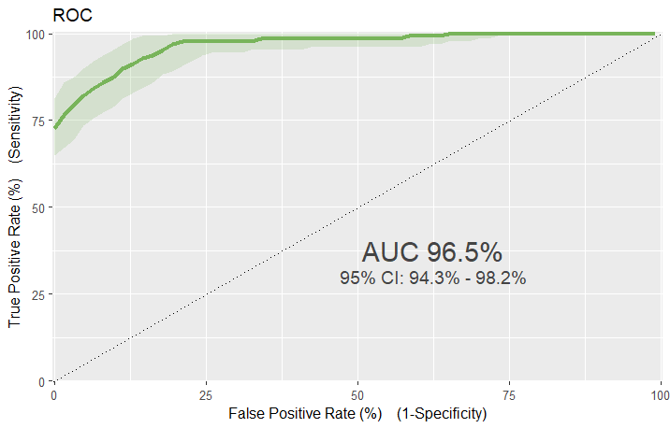
Results …(3/5)
Youden’s index=0.79:
S= 88.3 % (95% CI: 81.4–93.3), SP: 90.2% (95% CI: 83.6–94.9),
PPV= 90.4% (95% CI: 83.8–94.6),
NPV= 88.1% (95% CI: 81.1–93.7) and
Accuracy= 89.2% (95% CI: 84.7–92.8)
Predictive Model Performance

Slide 11
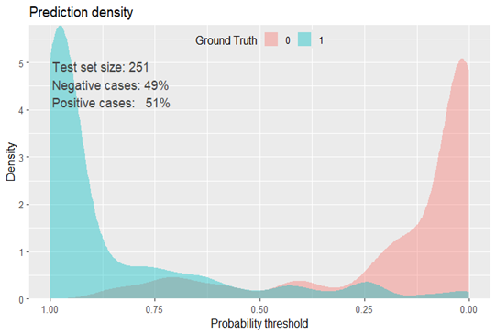
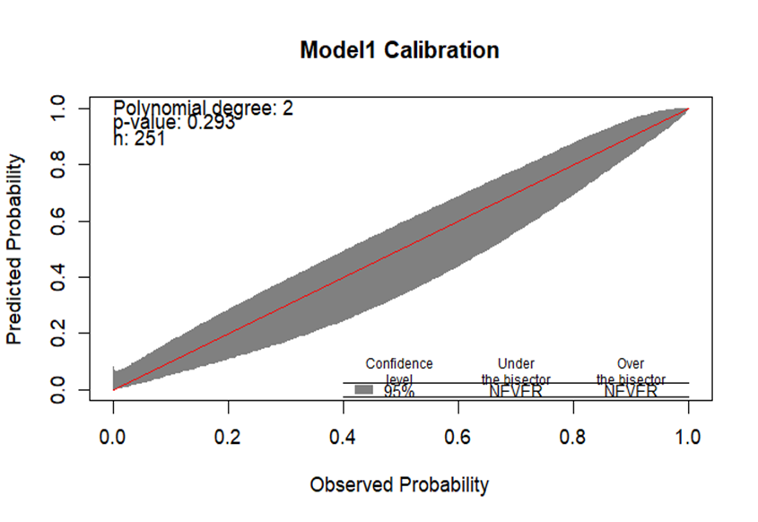
Results …(4/5)
The nomogram performance:
AUC 95.9% (95% CI: 94.2–98.2)
Calibration (Hosmer-Lemeshow p = 0.293)
>>Internal validation yielded a corrected AUC of 95%, and optimism coefficient of 0.0193.

Slide 12
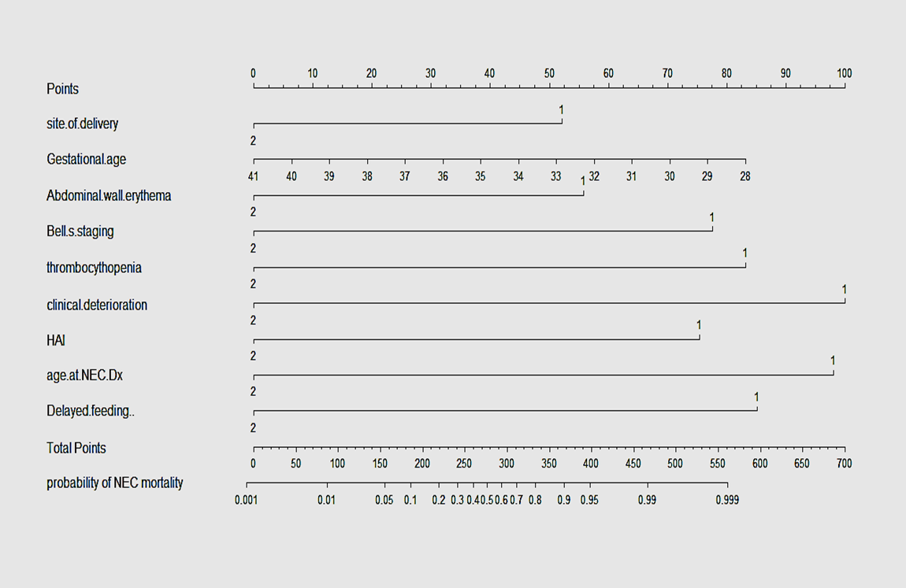
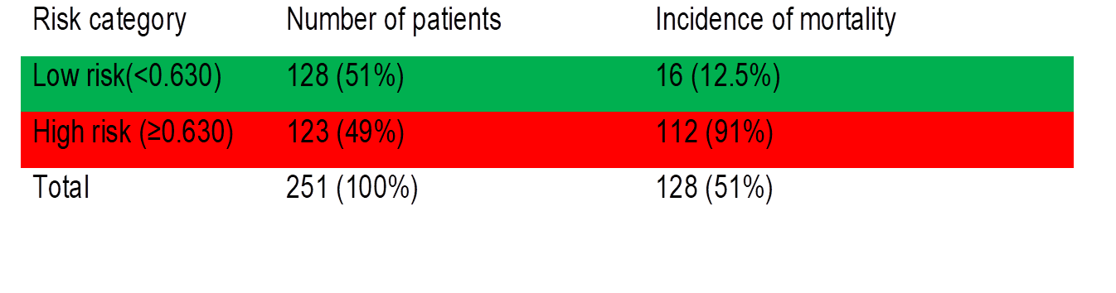
Results…(5/5)
A neonate with: G age: 32 weeks (≈ 38 points), Bell’s stage: Stage III (≈ 25 points), has thrombocytopenia (≈ 30 points), has clinical deterioration within 48 hrs (≈ 40 points), and whos age at NEC diagnosis: ≤3 days (≈ 35 points).
≈ 168. The estimated Probability of mortality: ≈ 70%
This neonate falls into a high-risk category for NEC-related mortality.
>>>indicating the need for aggressive monitoring and prioritized interventions.
The final reduced model used for nomogram development retained strong performance: AUC 95.9% (95% CI:

Slide 13
Discussion …(1/2)
NEC mortality in this cohort: 51% Lower than previous Ethiopian reports (57–82%) (Bimerew M et al, 2024), but still alarmingly high
Comparable to Indonesia (56%) & South Africa (49–52%) (Gitau K, Ochieng R et al, 2023)
Much higher than UK (18%), China (14.2%), Chile (18.6%) (Alsaied A, Islam N, Thalib L, 2020)
Implication: NEC remains a major contributor to neonatal mortality in low-resource settings due to delayed diagnosis, limited NICU capacity, and lack of surgical options.
APHI-FHEIA 4th Joint International Annual Research Conference

Slide 14
Discussion …(2/2)
Independent predictors (9):
  Outborn status
  Gestational age
  Early NEC onset (≤3 days)
  Delayed feeding (>48 hrs)
  Abdominal wall erythema
  Bell’s stage III
  Thrombocytopenia
  Clinical deterioration within 48 hrs
  Healthcare-associated infections
Clinical relevance: All are bedside-accessible, making the nomogram practical for resource-limited settings.
APHI-FHEIA 4th Joint International Annual Research Conference

Slide 15
Conclusion and Recommendations
Nomogram performance: Excellent discrimination (AUC ≈ 96%), good calibration, internally validated.
Clinical utility:
  Enables risk stratification and targeted interventions
  Supports integration into routine NICU protocols
Recommendation and next steps:
  External validation
  Incorporation into quality improvement initiatives
  Emphasize early feeding, infection control, and intensive monitoring for high-risk neonates.
APHI-FHEIA 4th Joint International Annual Research Conference

Slide 16
Acknowledgement
We acknowledge Bahir Dar University for granting us ethical approval to conduct our study.
We are also grateful to FHCSH and TGSH for providing permission to carry out the study.
Our sincere thanks go to data collectors and supervisors for their invaluable contributions.
Finally, we extend our deepest gratitude to the mothers and caregivers of neonates with NEC who participated in this study.
APHI-FHEIA 4th Joint International Annual Research Conference

Slide 17
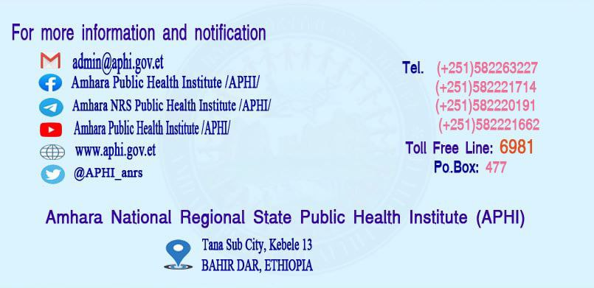
THANK YOU

