Slide 1
Person centred maternity care in humanitarian and fragile settings
Mr. Wubshet D. Negash^{1,2}, Professor Kamalini Lokuge², Em/Professor Cathy Banwell², Dr. Asmamaw Atnafu¹, Mr. Robera Olana²
¹National Centre for Epidemiology and Population Health, College of Law, Governance and Policy, The Australian National University, Canberra, Australian Capital Territory, Australia
²Department of Health Systems and Policy, Institute of Public Health, College of Medicine and Health Sciences, University of Gondar, Gondar, Ethiopia
Conference Theme: Health System Strengthening and Service Access in Crisis Settings
Amhara Public Health Institute - Forum for Higher Education Institutions in the Amhara Region 4th Joint International Annual Research Conference
December 4-5, 2025, Bahir Dar, Ethiopia

Slide 2
Presentation outlines
Background
Objectives
Methods
Result and Discussion
Conclusion and Recommendations
Acknowledgements
APHI-FHEIA 4th Joint International Annual Research Conference

Slide 3
Background…(1/2)
Person centered care has several definitions in different
literature; however, the most widely accepted definition is
“providing care that is respectful of and responsive to individual patient preferences, needs, and values and ensuring that the patient values guide all clinical decisions” ¹
1 Institute of Medicine (US) Committee on Quality of Health Care in America. (2001). Crossing the quality chasm: A new health system for the 21st century. Washington, DC: National Academies Press. https://doi.org/10.17226/10027
APHI-FHEIA 4th Joint International Annual Research Conference

Slide 4
Background…(2/2)
Evidences on SRH in humanitarian settings are scarce
PCMC remains overlooked despite global calls to improve care.
2/3rd global maternity death occurs in fragility and conflict affected countries.
More service; high maternal mortality indicates a fundamental gap in how services are delivered.
APHI-FHEIA 4th Joint International Annual Research Conference

Slide 5
Objectives …(1/1)
General Objective
To map available evidence on person-centered maternity care in humanitarian and fragile settings, including factors, and implemented interventions.
Specific Objectives
To synthesis the current evidences of person-centered maternity care in humanitarian and fragile settings.
To identify key factors of person-centered maternity care.
To summarize interventions implemented to improve person-centered maternity care.
APHI-FHEIA 4th Joint International Annual Research Conference

Slide 6
Methods …(1/2)
Data base:
PubMed, MEDLINE, EMBASE, PsycINFO, Scopus and generic web searches (Google Scholar).
Search strings
"Client centred care" OR experience OR expectation OR "Patient centred" OR "Person centred“ AND
"Antenatal care" OR abortion OR childbirth OR "Child birth" OR "Delivery care" OR "Emergency obstetric care" OR "Family planning" OR gestation* OR "Maternal health" OR "Maternal and newborn health" OR "Maternal newborn and child health" OR "Obstetric care" OR "Perinatal health" OR "Postnatal care" OR "Safe motherhood“ AND
"Armed conflict" OR conflict OR crisis OR emergency OR "Forced displacement" OR fragile OR "Internally Displaced Persons" OR humanitarian* OR insecurity OR refuge OR "Refugee camps" OR vulnerable OR war
APHI-FHEIA 4th Joint International Annual Research Conference

Slide 7
Methods …(2/2)
APHI-FHEIA 4th Joint International Annual Research Conference

Slide 8
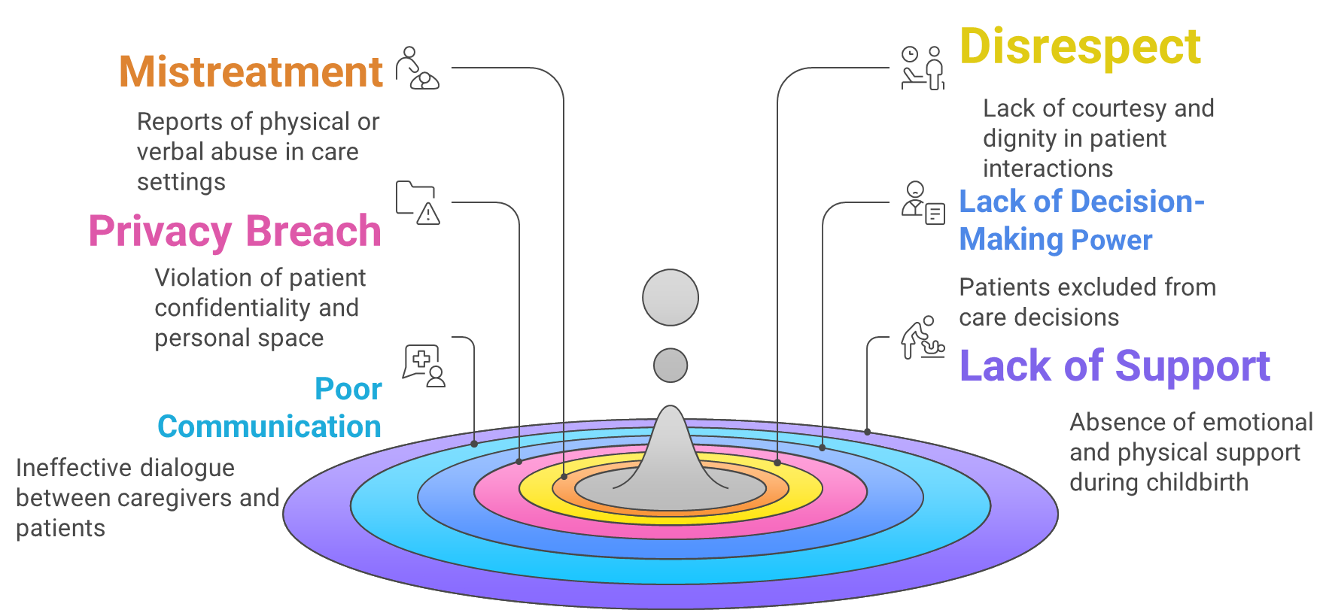
Results and Discussion …(1/3)
APHI-FHEIA 4th Joint International Annual Research Conference

Slide 9
Results and Discussion…(2/3)
Facilitators
Collaborations and mutual support
Availability of language translators
Training, capacity building, and community engagement
Barriers
Lack of understanding of patients’ culture
Persistent shortage of supplies and medication
Staff turnover and poor functional services.
APHI-FHEIA 4th Joint International Annual Research Conference

Slide 10
Results and Discussion …(3/3)
Promising approaches
Community engagement
Supportive supervision
Culturally sensitive communication strategies and
Task-shifting
APHI-FHEIA 4th Joint International Annual Research Conference

Slide 11
Conclusion and Recommendations …(1/2)
Women in humanitarian settings often receive poor person-centered maternity care.
Mistreatment, disrespect, poor communication, lack of autonomy, and privacy breaches are common.
Support from birth companions is frequently absent.
Limited evidence shows a need to better integrate PCMC into existing health systems.
More studies are required to fully assess all PCMC dimensions
APHI-FHEIA 4th Joint International Annual Research Conference

Slide 12
Conclusion and Recommendations …(2/2)
Integrate PCMC into humanitarian health programs.
Improve provider training on respectful and supportive care.
Ensure effective communication, privacy, and birth companionship.
Strengthen accountability to prevent mistreatment.
Conduct more primary research covering all PCMC core dimensions.
APHI-FHEIA 4th Joint International Annual Research Conference

Slide 13
Acknowledgements
ANU
Librarians
UOG
APHI
APHI-FHEIA 4th Joint International Annual Research Conference

Slide 14

THANK YOU

