Slide 1
Barriers and facilitators to Benzathine Penicillin G adherence in TASH: A mixed methods study of Rheumatic Heart Disease patients using the COM-B model
Habtamu Abera, RN, PhD & Dr Henok Tadele, MD Cardiologist
CHS, AAU
Conference Theme: Translating Research into Action: Strengthening Public Health Systems in Crisis-Affected Settings
Amhara Public Health Institute - Forum for Higher Education Institutions in the Amhara Region 4th Joint International Annual Research Conference
December 4-5, 2025, Bahir Dar, Ethiopia

Slide 2
Presentation outlines
Significance
Aims
Approach
Findings
Discussion and intervention recommendations
Acknowledgements
APHI-FHEIA 4th Joint International Annual Research Conference

Slide 3
Significance
Rheumatic Heart Disease (RHD) Burden in Ethiopia:
RHD endemic country with a prevalence of 17% in school and 37.5% in community-based studies among 4-25 years of age (Memirie et al., 2022)
RHD remains the most common acquired heart disease in Ethiopia (Yadeta et al., 2017; Berhanu et al., 2023; Mebrahtom et al., 2023)
Prevention and Control Strategies:
Provision of antibiotics, mostly Benzathine Penicillin G [BPG].
BPG injection reduces rheumatic recurrence by 55% (Manyemba, 2002 ) and stops RHD progression (Kumar et al., 2020; Manyemba, 2002 ).
BPG adherence of ≥80% is required to get maximum protection (WHO 2022, Adem et al., 2020; Kumar et al., 2020). However, BPG administration and maintaining optimal adherence level are key for RHD progression control.
Suboptimal adherence result in:
  4-fold odds of rheumatic recurrence and doubled odds of all-cause mortality (De Dassel et al., 2018).
  Severe valvular lesions will ultimately require a heart valve repair or replacement (Otto et al., 2021).

Slide 4
Significance: Gap
EBP
Current practice
BPG adherence over 80% is effective in prevention recurrences and RHD progression.
(WHO 2022, MOH 2017; Kumar et al., 2020).
Low BPG adherence
Know-do
55.2 to 77.9% (Mohammed et al., 2019; Adem et al., 2020; Mekonen et al., 2020; Zewde et al., 2021; Adal et al., 2022).
↑ RHD progression
↑ intervention demand → ↑ lengthy waiting time with limited access
Limited research
Barriers and facilitators to BPG adherence
Addressing barriers and capitalizing facilitators for BPG adherence are crucial

Slide 5
AIM: Identify barriers and facilitators of BPG adherence
To identify level of BPG adherence and associated factors among RHD patients
To explore lived experience of RHD patients on BPG
Specific objectives
To triangulate the findings for better understanding of BPG adherence

Slide 6
Approach: Theoretical Framework
COM-B suggests: Capability(C), Opportunity (O) and Motivation(M) are essential to any Behavior(B) to change
COM-B/BCW framework includes not only behavior sources but also intervention functions and policy categories.
Figures 1: COM-B & BCW (Michie et al., 2014)
Notes:
Capability(C): refers to the individual’s psychological and physical capability; encompasses knowledge and skills required to perform a desired behavior (e.g., knowledge of BPG prophylaxis etc.).
Opportunity(O): includes physical environment and social influences such as resources, healthcare access, and social support (e.g., BPG supply etc.).
Motivation(M) [reflective and automatic responses] is all the cognitive/brain process that motivates and directs a behavior, such as emotional responding and analytical decision making (e.g., trust in healthcare, belief) (Michie et al., 2011).
COM-B stands for Capability Opportunity Motivation – Behaviour. The COM-B model is the starting point used by the BCW for understanding behaviour in the context in which it occurs. The central tenet of the model is that for any behaviour to occur:
1. there must be the ‘capability’ to do it: the person or people concerned must have the physical strength, knowledge, skills, stamina etc. to perform the
behaviour;
2. there must be the ‘opportunity’ for the behavior to occur in terms of a conducive physical and social environment: e.g. it must be physically accessible,
affordable, socially acceptable and there must be sufficient time;
3. there must be sufficient strong ‘motivation’: i.e. they must be more highly motivated to do the behavior at the relevant time than not to do the behaviour, or to
engage in a competing behaviour

Slide 7
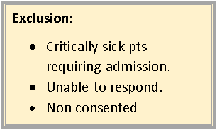
Design: Convergent mixed methods
To date, the reason why BPG adherence is low and varies across settings and population group is unknown
Quantitative study
Qualitative study
Survey
(Age: 12-40, n=346 RHD patients on BPG:1 year, SRS)
In-depth interview with 21 RHD patients (age: ≥ 18), purposive sampling with participants stratification based on….
Analysis: Epi-data, SPSS
Descriptive and inferential statistics
Analysis: Atlas ti., thematic analysis
Adherence level assessed for the 12 months preceding enrollment: considered good if ≥ 80% BPG prophylaxis uptake (≥ 10 injections/year)
Data integration
Data sources: used tool adapted from previous studies and aligned with COM-B components.
Notes:
The final findings of both data sets will be triangulated for the better understanding of the study findings and will be presented in joint display under COM-B domains

Slide 8
Findings
Quantitative
Qualitative
15 females and 14 urban areas.
Age ranges 18 to 40 years.
15 of them have no regular job
Lack of physical strength:
“It is unthinkable to come alone to get my regular monthly BPG injection. I feel tired and have difficulty breathing. (R8).
“The time we have here for connecting with other patients is so limited, no one give us the opportunity” (R15)
Inadequate knowledge of RHD and its treatment
Many of the participants directly said: “I do not know much about my heart disease.” [R14F, R15F, R17F, R19F].
Most resided in an urban area, 72.3%.
37.3% were employed.
73.4% had HI coverage
37.3% RHD patients received support from their family members,
51.7% of RHD patients reported an opportunity to discuss their RHD illness with similar RHD patients.
46.2%, of RHD patients had poor or very poor knowledge concerning RHD, and its prevention.

Slide 9
Findings…
Quantitative…
Qualitative…
Limited healthcare capability in the provision of BPG
“no significant support” [R13]
“There is no healthcare support system in place to support the Benzathine penicillin program.” (R9).
Cost of medication/ treatment
“At private clinics, they provide you much care. But it is very expensive and there were times that I couldn’t get enough money to buy the medication’’ (R6)
64.5% of RHD patients received BPG from government health facilities
84.7% of respondents cited problems with the BPG supply.

Slide 10
Findings …
Quantitative…
Qualitative….
Financial constraints
“It is difficult to strictly attend follow-up schedules due to various reasons like lack of money for transportation, daily expenses, and medical treatments and so on.” (R10).
Distance:
A 35-year-old female RHD patient stated that she opted to pay over 10,000ETB for travel, treatment and other expenses because it took her two days to get here(R14).
The median monthly transportation cost was 65 ETB (IQR: 10-250).
Low level of adherence: (72.3% Vs 80%).
15.6% knowingly avoided BPG injections.
49.7% missed a regular BPG injections in the last year
  Distance: inability to afford and painful BPG injection were the main reasons for missed BPG injections

Slide 11
Findings…
Quantitative…
Qualitative….
80.6% of RHD patients trusts the healthcare provider for BPG injections
81.5% have perception of BPG effectiveness
30 minutes was the median wait time (IQR: 15–60) for a BPG injection.
Lack of trust in HCPs
“I have doubts about healthcare providers, and I don’t trust all of them. They always look unhappy about the drug (BPG). They are in fear, and I don’t want them to give me the medication.” (R9).
waiting time
“There was a time when they left me waiting there for a long time and leave me there/tell me to return in the afternoon when I go there in the morning. There is always a hustle. That is why I skipped the days.” (R12).

Slide 12
Findings: Qualitative….
Unwillingness of Healthcare providers to provide injection
  “I have tried many private clinics and health centers and none of them were welcoming to treat me as any other patients. That was why I decided to stop my injection again for six months and came today to try another healthcare facility near me” [R13].
  “Benzathine injection providers are not welcoming.” [R2].
Attitude towards medication
  “I have some frustrations ………the healthcare providers always say if you die here, who is responsible? Then, for a period of time, I stopped the medication” [R10].

Slide 13
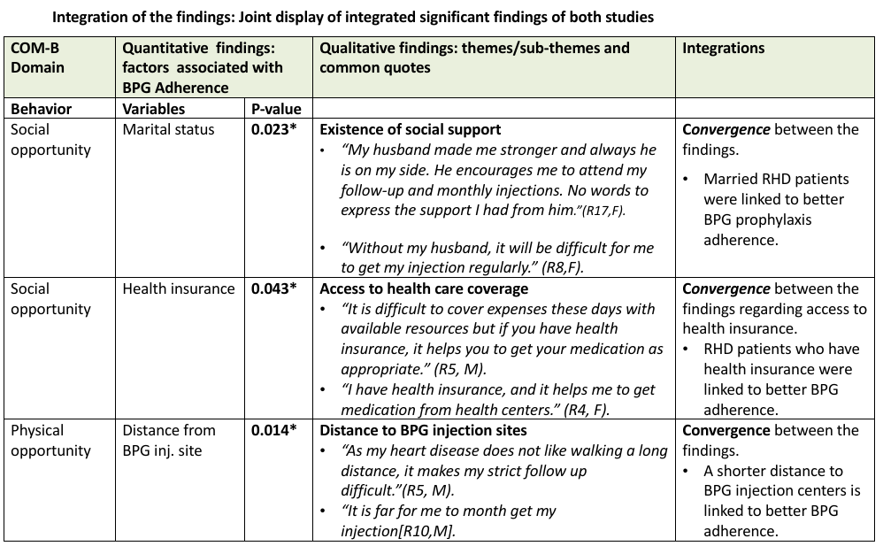
Mixed study findings: Data integration and mapping findings

Slide 14
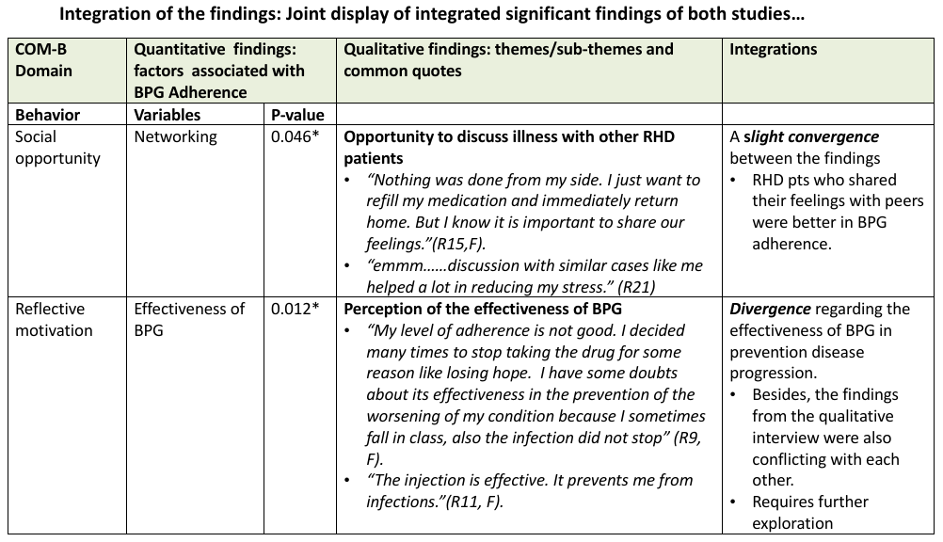
Mixed study findings: Data integration and mapping findings

Slide 15
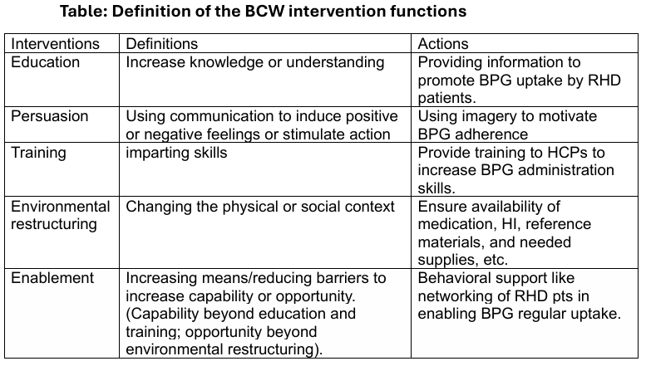
Discussion and interventions

Slide 16
Discussion and interventions
A sub-optimal level of BPG adherence is documented.
Distances from BPG injection centers remain barrier, the finding corroborate prior studies (Adal et al., 2022; Adem et al., 2020; Mekonen et al., 2020; Mohammed et al., 2019; Zewde and Mekonnen, 2021).
  BCW interventions functions: Environmental restructuring such as decentralization of the BPG prophylaxis program making it available at community level health facilities to improve BPG adherence (Areri et al., 2024; Chamberlain-Salaun et al., 2016; Longenecker et al., 2017; Palafox et al., 2017)
Support[family, network] showed a positive association with BPG adherence, which is also documented in other studies (Areri et al., 2024, Lutfian et al., 2025; Shahin et al., 2021).
  Interventions: Persuasion and enablement intervention functions should be utilized.
Health insurance coverage also showed a positive association with BPG adherence in this study (Areri et al., 2024; Edwards et al., 2021b).
  Interventions: Environmental restructuring: HI. In line with intervention recommendation, the current health insurance schemes in Ethiopia need to be expanded to address among RHD patients. (Argaw et al., 2023; Merga et al., 2022)
The perceived benefit of BPG prophylaxis: it could be linked to the absence of physical RHD symptoms, hospital admission and understanding the effect of missed BPG prophylaxis (Areri et al., 2024, Eshete et al., 2023; G et al., 2023).
  Interventions: enablement and education of RHD patients could include the benefit of BPG on RHD progression and overall health (Michie, 2014).

Slide 17
Conclusions
An implementation strategy that considers:
  enhancing awareness of prophylaxis: education, persuasion
  Distance: environmental restructuring., e.g., decentralized service
  ensured BPG access: environmental restructuring; e.g., HI, BPG supply
  ensured support and networking should be considered to improve BPG adherence among RHD patients.
Context specific implementation strategy is designed and looking for Fund to start piloting

Slide 18
Acknowledgments
Funding: NIH[1D43TW012459-01]
College of Health Sciences, AAU
Rollins School of Public Health, Emory
Nell Hodgson Woodruff School of Nursing, Emory University
APHI

