Slide 1
Severity of Wasting Among Children Aged 6–59 Months in East Africa: A Multilevel Proportional Odds Analysis of DHS Data from 2012-2022
Presenter: Masrie G.
Affiliation: Epidemiology and Biostatistics Department, Jimma University, Ethiopia & Department of Public Health and Primary Care (GE39), Ghent University, Belgium.
Fourth Joint International Annual Research Conference (JIARC-2025)
Bahirdar, Ethiopia
December, 2025

Slide 2
Outlines
Background
Objectives
Methods
Results
Discussion
Conclusion
Recommendation
Acknowledgment
References

Slide 3
Background
Wasting (acute undernutrition) is a severe form of malnutrition defined by low weight-for-height, leading to rapid weight loss and high risk of child mortality.
It is a public health challenges specifically for both low and middle-income countries.
(UNICEF, 2023)

Slide 4
Global Burden
45 million children under-five affected by wasting.
Undernutrition contributes to ~45% of under-five deaths.
Wasting in Sub-Saharan Africa
Region carries one of the heaviest global burdens
Prevalence ranges 5–7% in East Africa
Significant barrier to achieving child health goals.

Slide 5
Why Wasting Matters?
Affects:
Physical growth,
Cognitive development,
Immune function,
Demands urgent public health action, especially in low-income regions.
(Black et al. 2013)

Slide 6
Why this finding is important ?
This study provides up-to-date, and regionally representative evidence on the burden and severity of child wasting in East Africa.
Helping prioritize countries and communities most in need of wasting.
The identification of high-risk subgroups.
It provides an insights for policy makers and higher officials.

Slide 7
Objectives
Assess Wasting Severity: Estimate the overall prevalence of wasting and its severity levels (moderate and severe) among children aged 6–59 months in East Africa using recent DHS data (2012–2022).
Identify the contributing factors: factors both at the individual level (child, mother, household characteristics) and community level that are associated with higher severity of child wasting across East African countries.

Slide 8
Methods
Study Design and Settings
Population-based, cross-sectional study
DHS data (2012–2022) from 7 East African countries (Ethiopia, Kenya, Uganda, Tanzania, Rwanda, Comoros, Madagascar).
Region characterized by:
Diverse geography & socio-economic conditions
Share common challenges: political instability, infectious diseases, poverty, food insecurity.

Slide 9
Data source
Data obtained from the MEASURE DHS database
(https://dhsprogram.com/data/)
Access granted following approval from the DHS Program Office
Analysis used the Kids Recode (KR) dataset
Sample
Total of 42,413 children included
Age range: 6–59 months
Pooled from seven East African DHS surveys

Slide 10
Sampling Procedures
DHS uses two-stage stratified cluster sampling.
Stage 1: Select Enumeration Areas (EAs) using Probability Proportional to Size (PPS).
Stage 2: Systematic selection of 20–30 households per EA.
Eligible respondents: Women 15–49 years in selected households.
Sampling weights applied to ensure national & regional representativeness.

Slide 11
Study Variables
Dependent Variable: Severity of Wasting
Based on Weight-for-Height Z-score (WHZ)
Normal: WHZ ≥ −2
Moderate wasting (MAM): −3 ≤ WHZ < −2
Severe wasting (SAM): WHZ < −3
Classified according to WHO Child Growth Standards.

Slide 12
Independent Variables
Individual-Level Variables
Household characteristics
Water source
Toilet type
Household size
Number of under-five children
Sex of household head
Media access
Wealth index

Slide 13
Maternal characteristics
Mother’s education
Age at first birth
Health facility visits in past 12 months
Place of delivery
Employment status
Partner’s education
Maternal BMI
Child characteristics
Birth type
Sex of child
Birth size
Cough/fever in last two weeks
Child’s age

Slide 14
Independent Variables (Community Level)
Place of residence
Community-level media exposure
Community maternal education
Community wealth index
Community maternal employment
Derived by aggregating individual-level variables
Categorized as:
Low: cluster median < national median
High: cluster median ≥ national median

Slide 15
Statistical Analysis
In this study, Multilevel Proportional Odds Model (due to hierarchical data):
Children nested in households → households nested in clusters
Four models:
Null model (contained no predictors),
Model I (individual-level predictors),
Model II (community-level predictors), and
Model III full model (individual + community-level predictors).

Slide 16
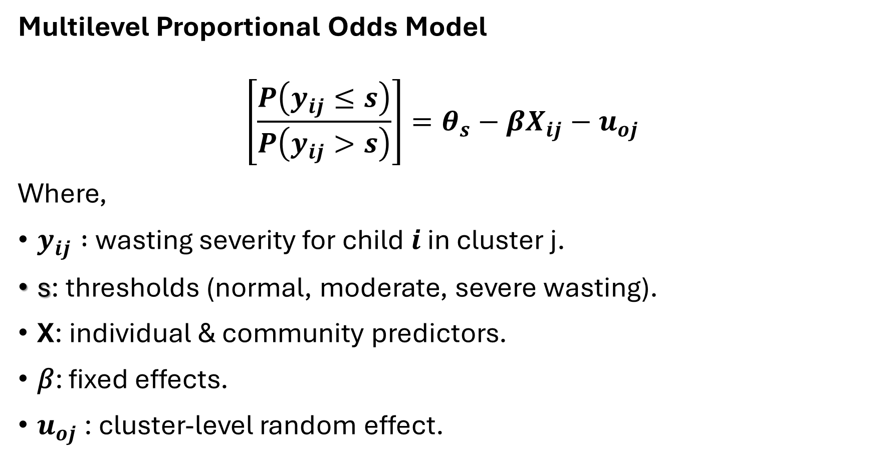
Model Specification
Multilevel Proportional Odds Model
$$\left[\frac{P\left(y_{ij}≤s\right)}{P\left(y_{ij}>s\right)}\right]=θ_{s}−{βX}_{ij}−u_{oj}$$
Where,
$y_{ij} :$wasting severity for child 𝒊 in cluster j.
s: thresholds (normal, moderate, severe wasting).
X: individual & community predictors.
𝛽: fixed effects.
$u_{oj}$​: cluster-level random effect.

Slide 17
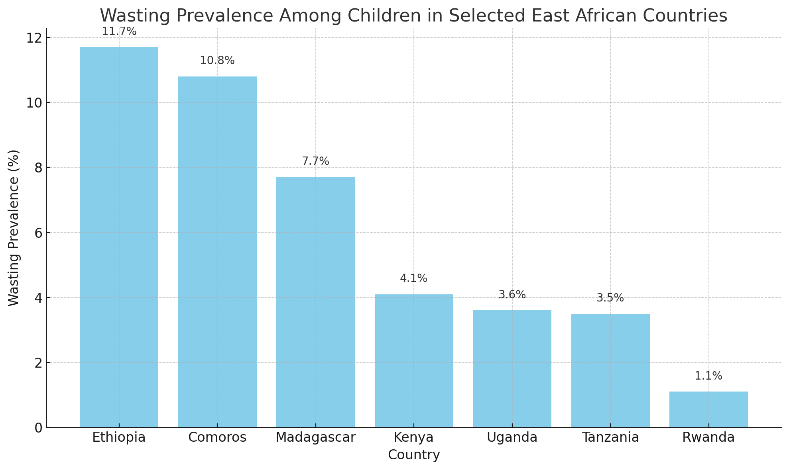
Key Findings / Results
Prevalence of wasting among children in East Africa
Overall wasting prevalence: 7.2% (5.7% MAM, 1.5% SAM).
By Country: • Ethiopia: 11.7% (highest) • Comoros: 10.8% • Madagascar: 7.7% • Rwanda: 1.1% (lowest) • Uganda: 3.5%

Slide 18
Background characteristics
Individual-Level Characteristics
Maternal Characteristics
31% had primary education or less,
38% delivered at home;
31% had first child <18 yrs
Child Characteristics
Sex distribution: 51% male, 49% female,
2.7% multiple births;
Size of child at birth: 28% large & 20% small
Recent illness: 23% cough; 19% fever.

Slide 19
Household Child Characteristics
51% used unimproved drinking water
57% used unimproved toilet facilities
>50% had more than five family members
75% had no media exposure
Community-Level Characteristics
75% of children lived in rural areas
86% of mothers had low education at community level
81% of children from low-wealth communities

Slide 20
Model Summary
Significant cluster effect: p < 0.001 → Confirms the need for multilevel modelling
ICC (Null Model): 9.1% → 9.1% of variance in wasting severity is due to cluster differences.
Model I (Individual-level predictors)
ICC: 4.6%
Explains 53.3% of between-cluster variance
Model II (Community-level predictors)
ICC: 7.3%
Explains 22% of between-cluster variance
Model III (Full model: Individual + Community)
ICC: 4.4%
Explains 55% of between-cluster variance

Slide 21
Significant predictors
No health facility visit → OR 1.15 (1.05–1.26) → ↑15%
Mother not employed → OR 1.29 (1.18–1.41) → ↑29%
Maternal BMI
Underweight → OR 1.91 (1.71–2.13) → ↑91%
Overweight → OR 0.72 (0.64–0.82) → ↓28%
Female child → OR 0.78 (0.72–0.84) → ↓22%

Slide 22
Birth size
Small → OR 1.89 (1.71–2.10) → ↑89%
large → OR 1.21 (1.10–1.33) → ↑21%
Child age group
6–11 months → OR 1.85 (1.55–2.21) → ↑85%
12–23 months → OR 1.40 (1.20–1.63) → ↑40%
Fever in last 2 weeks → OR 1.30 (1.18–1.42) → ↑30%
(The detailed can be found in Table 3)

Slide 23
Discussion
Overall, 7.2% of children aged 6–59 months are wasted (5.7% MAM, 1.5% SAM), aligned with global East African average (6.8%) [Black et al., 2013].
Highest in Ethiopia (11.7%), Comoros (10.8%), Madagascar (7.7%), these countries are still face challenges to food security, conflict, poor healthcare infrastructure, and droughts that exacerbate the higher risk of wasting [Black et al. 2013, UNICEF et al. 2023].
Lowest in Rwanda (1.1%), Rwanda has made a significant progress to improve maternal and child health, and poverty reduction. In addition, a robust community health program and national strategies that has been carried out aiming to reduce undernutrition [Binagwaho et al. 2016].

Slide 24
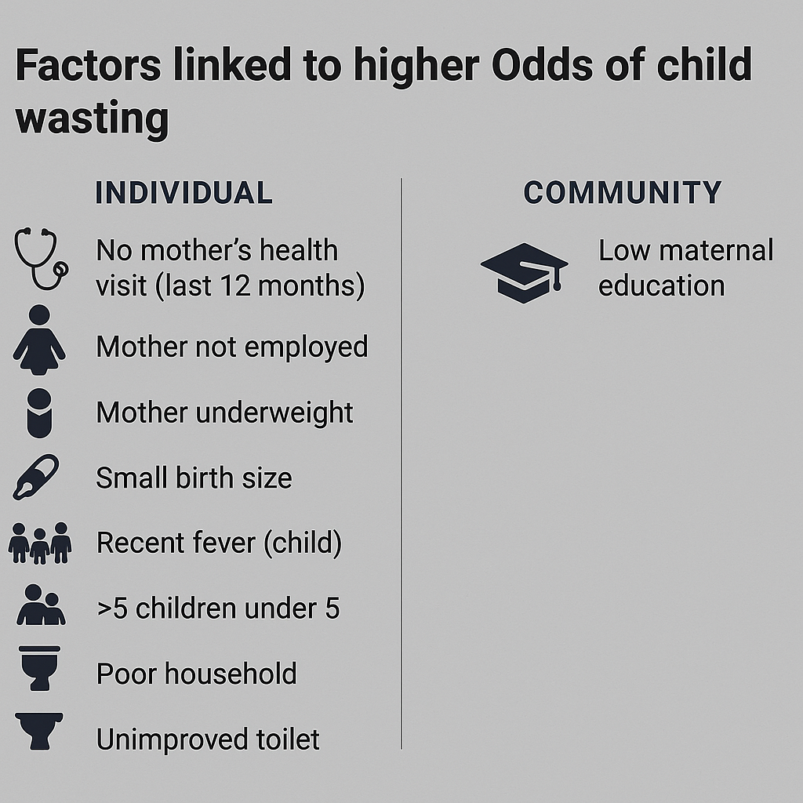
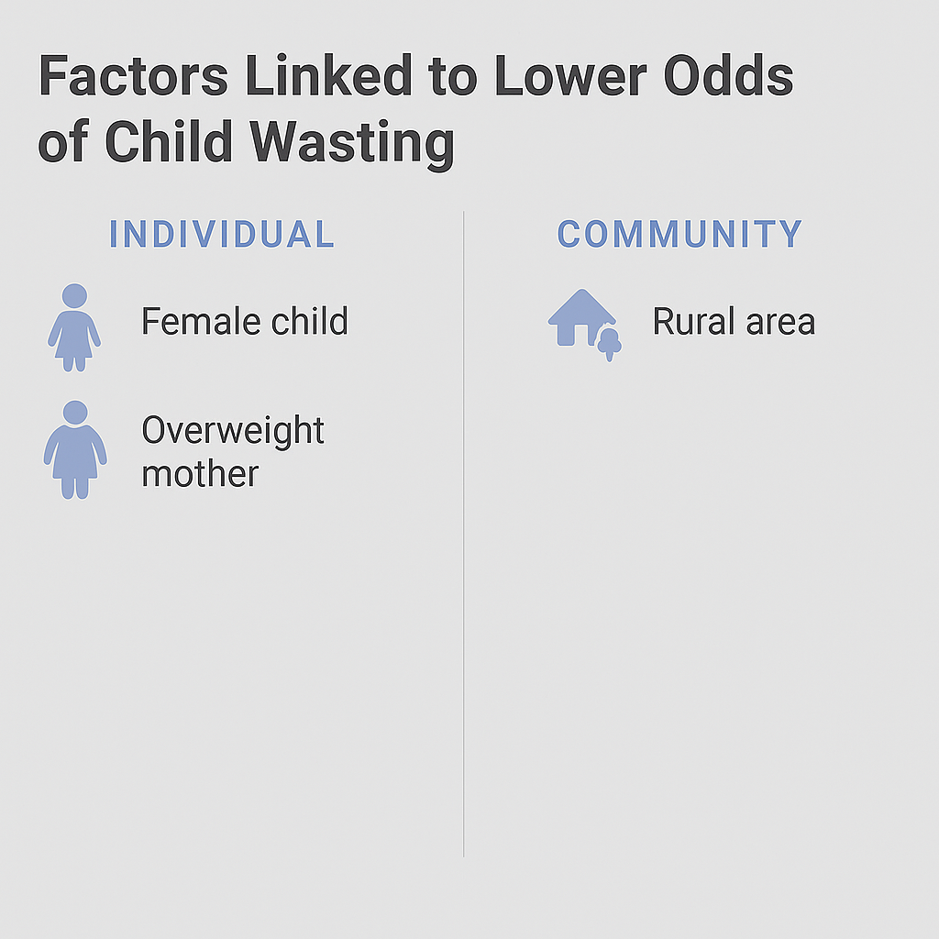
[Binagwaho etal.2016; Yaya etal.2021]

Slide 25
Children of unemployed mothers had higher odds of severe wasting than those with employed mothers.
This study is consistent with (Hossain etal. 2020) showing that unemployed mothers can reduce the households income, limit access to divers and nutritious foods, delay timely health care, restrict other essential resources for children, all of which contribute to increased severity of wasting.

Slide 26
Children born small in size had higher odds of severe wasting, consistent with
Low-birth-weight infants are more vulnerable to:
Growth faltering & infections (Christian et al., 2013)
Feeding difficulties that worsen wasting (Black et al., 2013).
Children 6–11 months old have higher odds of severe wasting compared to those aged 48–59 months, consistent with
Highly dependent on breastfeeding + complementary feeding → greater nutrition vulnerability (Lauriola et al. 2021).
Immature immune system → more prone to diarrhea & infections linked to wasting (Black et al., 2013).
Rapid growth phase requires high energy; inadequate intake → quick progression to wasting (Dewey et al. 2011).

Slide 27
Conclusion
Wasting remains high in East Africa, with large differences between countries—showing unequal progress and persistent vulnerability.
Both individual-level (maternal health, child factors, household conditions) and community-level (education, residence, wealth) factors jointly influence wasting severity.

Slide 28
Recommendation
✅ Empower Mothers
Scale up maternal education and employment initiatives to reduce child undernutrition risks.
✅ Strengthen Health Systems
Improve access to maternal and child health services, especially in underserved communities.
✅ Target High-Burden Areas
Prioritize Ethiopia, Comoros, and Madagascar with tailored nutrition interventions.
✅ Promote Community-Based Programs
Invest in rural health outreach, sanitation, and awareness on child feeding and care.

Slide 29
Acknowledgment
DHS program provide.
Amhara Public Health Institute and Amhara Regional Health Bureau.

Slide 30
References
1. World Health Organization, United Nations Children's F, International Bank for R, Development/The World B. Levels and trends in child malnutrition: UNICEF / WHO / World Bank Group joint child malnutrition estimates: key findings of the 2023 edition. Geneva: World Health Organization; 2023 2023.
2. Black RE, Victora CG, Walker SP, Bhutta ZA, Christian P, de Onis M, et al. Maternal and child undernutrition and overweight in low-income and middle-income countries. Lancet. 2013;382(9890):427-51.
3. World Health O, United Nations Children's F. WHO child growth standards and the identification of severe acute malnutrition in infants and children : joint statement by the World Health Organization and the United Nations Children's Fund. Geneva: World Health Organization; 2009.
4. Paré BC, Dahourou DL, Kabore A, Sana A, Kinda R, Ouaro B, et al. Prevalence of wasting and associated factors among 6 to 23 months old children in the Sahel Region of Burkina Faso. Pan African Medical Journal. 2019;34(1).
5. Harding KL, Aguayo VM, Webb P. Factors associated with wasting among children under five years old in South Asia: Implications for action. PloS one. 2018;13(7):e0198749.
6. Nations FaAOotU. FIGURE 13. Prevalence of wasting among children under five years of age in Africa by subregion and country (2015 to 2022). 2023.
7. Tamir TT, Tekeba B, Aemro A, Wassie M, Mekonen EG. Prevalence, spatial distribution, and determinants of wasting among children under five in Senegal: spatial and multilevel analyses of the 2023 Senegal Demographic and Health Survey. Frontiers in Public Health. 2025;13:1543945.
8. Asebe HA, Asmare ZA, Mare KU, Kase BF, Tebeje TM, Asgedom YS, et al. The level of wasting and associated factors among children aged 6–59 months in sub-Saharan African countries: multilevel ordinal logistic regression analysis. Frontiers in Nutrition. 2024;11:1336864.

Slide 31
Thank you!

