Slide 1
Exploring Health system challenges for crisis response in Ethiopia: a scoping review of publications and reports from 2020-2024
By Endalkachew Dellie
(University of Gondar)
Conference Theme: Translating Research into Action: Strengthening Public Health Systems in Crisis-Affected Settings
Amhara Public Health Institute - Forum for Higher Education Institutions in the Amhara Region 4th Joint International Annual Research Conference
December 4-5, 2025, Bahir Dar, Ethiopia

Slide 2
Presentation outlines
Background
Objectives
Methods
Results
Conclusions
Acknowledgements
APHI-FHEIA 4th Joint International Annual Research Conference

Slide 3
Background(1/2)
Ethiopian healthcare systems face increasing shocks (conflict, pandemics, outbreaks).
These crises disrupted healthcare delivery, quality of care, and increased vulnerability of the affected population
The conflict in Ethiopia caused extensive health-facility damage, with
  76 hospitals, 750 HCs, and 3,508 HPs have been destroyed, looted or completely damaged across four regions
COVID-19 pandemic disrupt essential health services (54% and 47% reduction in OPD visit and inpatient admissions in AA)
(Arage et al., 2023a, Gutema et al., 2023a, Berhan et al., 2023, Gudina et al., 2021, Brecher and Wilkenfeld, 2022, Abagero et al., 2022a ).
APHI-FHEIA 4th Joint International Annual Research Conference

Slide 4
Background(2/2)
Understanding challenges across the HS is essential for effective crisis management and response.
However, limited previous work has produced a synthesized evidence of these findings across the HS in Ethiopia.
Those studies were focused on specific health system building blocks and for specific crisis.
Objective
To explore and synthesize existing evidence on health system challenges during crisis
To suggest strategies to build sustainable and resilient health systems
APHI-FHEIA 4th Joint International Annual Research Conference

Slide 5
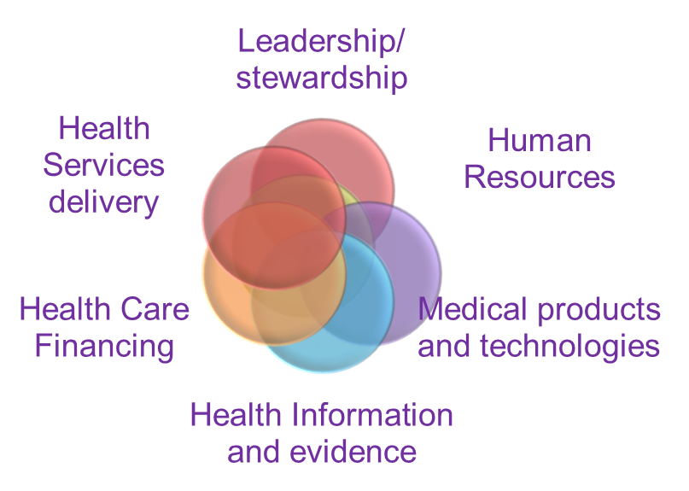
Methods (1/1)
A systematic scoping review following Arksey & O’Malley framework
The PRISMA- ScR was used for reporting
The population, concept, and context (PCC) framework defines selection criteria
All studies or reports published in English and accessible full text irrespective of the study design, conducted in Ethiopia (2020-2024) were included
(Peters et al., 2020,; Arksey and O'Malley, 2005)
Health System Building Blocks, The WHO framework
APHI-FHEIA 4th Joint International Annual Research Conference

Slide 6
Result(1/4): Study characteristics
APHI-FHEIA 4th Joint International Annual Research Conference

Slide 7
Results(2/4)
HS Building block | Challenges to crisis response
Health workforce | Insufficient ongoing CPD and crisis-specific training-----impaired to adapt to emergency protocols, compromising care quality and increasing infection risks Poor working conditions, limited career advancement, and high staff turnover further demoralize the workforce and diminish crisis response capacity (Firew et al., 2020, Zewudie et al., 2021, Mitike et al., 2023; Mihretie et al., 2024, Gebrekidan et al., 2023)
Service delivery | Disruption of routine health services: COVID‑19 and conflict led to sharp declines in outpatient visits, inpatient admissions, elective surgery, and RMNCH services Infrastructure damage and facility closures Resource reallocation Decreased demand for services Compromised Quality of Care (Shuka et al., 2022, Shimels and epidemiology, 2021, Tefera et al., 2021; Abraha et al., 2023; (Birihane et al., 2020, Abagero et al., 2022b, Taye et al., 2024)
APHI-FHEIA 4th Joint International Annual Research Conference

Slide 8
Results(3/4)
HS Building block | Challenges to crisis response
Medical products and technology | Supply chain disruptions and shortages Critical shortages of medical supplies, ventilators, equipment, and oxygen Insecurity disrupted flows from central stores to peripheral facilities, including routine vaccines (BCG, OPV, IPV, PENTA) Transportation disruptions and border closures (Abagero et al., 2022b; Mekonnen et al., 2023, Deressa et al., 2021; Melaku et al., 2024, Ejeta et al., 2021)
Healthcare Financing | Insufficient financial resources allocation for health services Inefficient use of available financial resources including mismanagement and lack of transparency in the allocation and utilization of funds Dependency of the health system on external aid and donor funding (Debie et al., 2022; Abagero et al., 2022a,; Mumin et al., 2021)
APHI-FHEIA 4th Joint International Annual Research Conference

Slide 9
Results(4/4)
HS Building block | Challenges to crisis response
Leadership and Governance | Poor coordination and communication between various levels of government and health institutions Lack of accountability Week comprehensive emergency preparedness plans (Assefa et al., 2022; Rawat et al., 2022, Debela, 2020; Abagero et al., 2022a)
Health Information and evidences | Poor quality and incomplete data Limited digitalization, destruction of HIS infrastructure, damage or loss of patient records, financial documents, logistics files, and administrative archives impede disease and service trend monitoring, epidemic identification, and quality health service provision (Taye et al., 2024)
APHI-FHEIA 4th Joint International Annual Research Conference

Slide 10
Conclusion and Recommendations (1/2)
Ethiopia’s health system faced widespread and interconnected challenges during crises
The health system resilience remains limited
Strengthening resilience is essential for future shocks
  Develop and institutionalize crisis‑specific training and CPD for all HWFs
  Diversify supply sources, and develop contingency logistics plans for conflict‑ and disaster‑prone areas.
  Increase domestic financing for health resilience and reduce over-reliance on external aid.
  Strengthen coordination and communication between different levels of government and health institutions to ensure timely and effective crisis responses
APHI-FHEIA 4th Joint International Annual Research Conference

Slide 11
Conclusion and Recommendations (2/2)
  Clarify data governance and emergency communication protocols across HS hierarchy
  Ensuring efficient and transparent use of healthcare resources
  Ensure accountability
APHI-FHEIA 4th Joint International Annual Research Conference

Slide 12
Sample References
Kentikelenis A, Papanicolas I: Economic crisis, austerity and the Greek public health system. The European journal of public health 2012, 22(1):4-5.
Kieny M-P, Evans DB, Schmets G, Kadandale S: Health-system resilience: reflections on the Ebola crisis in western Africa. In., vol. 92: SciELO Public Health; 2014: 850-850.
Massuda A, Hone T, Leles FAG, De Castro MC, Atun R: The Brazilian health system at crossroads: progress, crisis and resilience. BMJ global health 2018, 3(4):e000829.
Jordan K, Lewis TP, Roberts B: Quality in crisis: a systematic review of the quality of health systems in humanitarian settings. Conflict and health 2021, 15:1-13.
Martineau T, McPake B, Theobald S, Raven J, Ensor T, Fustukian S, Ssengooba F, Chirwa Y, Vong S, Wurie H: Leaving no one behind: lessons on rebuilding health systems in conflict-and crisis-affected states. BMJ global health 2017, 2(2):e000327.
Brunn M, Brigham KB, Chevreul K, Hernández-Quevedo C: The impact of the crisis on the health system and health in France. Economic crisis, health systems and health in Europe 2015:75.
Lindelow M, Serneels P: The performance of health workers in Ethiopia: results from qualitative research. Social science & medicine 2006, 62(9):2225-2235.
Erena SH, Worku H: Urban flood vulnerability assessments: the case of Dire Dawa city, Ethiopia. Natural Hazards 2019, 97:495-516.
Gebrehiwot T, van der Veen A: Climate change vulnerability in Ethiopia: disaggregation of Tigray Region. Journal of Eastern African Studies 2013, 7(4):607-629.
Ahmad T, Cressman K, Noorka IR, Omrane MB, Bader MK: Burgeoning desert locust population as a transboundary plant pest: A significant threat to regional food security. In: The Food Security, Biodiversity, and Climate Nexus. edn.: Springer; 2022: 189-212.

Slide 13
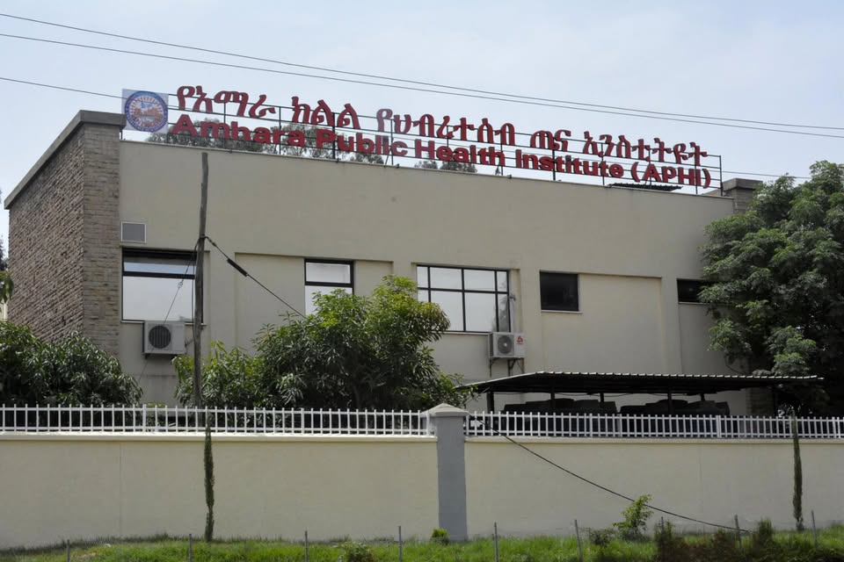
THANK YOU

