Slide 1
Post-Traumatic Stress Disorders among Sexual and Gender-Based Violence survivors in war-affected zones in Ethiopia.
By:Tamrat anbesaw (MSc)
Affiliation: Wollo University
Conference Theme: Mental Health and Psychosocial Support in Emergencies
Amhara Public Health Institute - Forum for Higher Education Institutions in the Amhara Region 4th Joint International Annual Research Conference
December 4-5, 2025, Bahir Dar, Ethiopia

Slide 2
Presentation outlines
Background
Objectives
Methods
Result and Discussion
Conclusion and Recommendations
Acknowledgements
APHI-FHEIA 4th Joint International Annual Research Conference

Slide 3
Background…(1/2)
PTSD follows trauma with re-experiencing, avoidance, negative mood, hyperarousal (American Psychiatric Association, 2013)
SGBV in conflicts heightens PTSD risk, affecting 35% women globally (Tappis et al., 2016)
Ethiopia reports 71% violence against women, worsened by 2021 Northern conflict (van Hennik, 2020; Plaut, 2021)
Conflict displaced 2M, increasing SGBV and mental health vulnerabilities
One-stop centers offer integrated care but face stigma and access barriers (Undie et al., 2012)
APHI-FHEIA 4th Joint International Annual Research Conference

Slide 4
Background…(2/2)
Global prevalence: 63% Nigeria, 88% Colombia, 68.9% Palestine
(Taru et al., 2018), (Richards et al., 2021), (Pham et al., 2023)
Risk factors: younger age, single status, displacement, economic burden (Capasso et al., 2021).
Untreated PTSD impairs recovery, social function, quality of life.
Study fills gap in war-affected Northeast Ethiopia one-stop centers.
APHI-FHEIA 4th Joint International Annual Research Conference

Slide 5
Objectives …(1/1)
Main objective:
Determine PTSD prevalence and associated factors among SGBV survivors in Northeast Ethiopia (2022).
Specific objectives:
To determine the prevalence of PTSD among SGBV victims attending one-stop centers in Northeast Ethiopia, 2022.
To identify factors associated with PTSD among SGBV victims attending one-stop centers in Northeast Ethiopia, 2022.
APHI-FHEIA 4th Joint International Annual Research Conference

Slide 6
Methods …(1/2)
Cross-sectional study (Dec 2022–Jan 2023)
Sites: One-stop centers in South Wollo, North Wollo, Waghimra zones
Participants: 321 SGBV survivors ≥15 years (100% response)
Systematic random sampling; sample size 321 (p=0.5, 5% margin)
Data: Face-to-face interviews; ethical clearance obtained.
APHI-FHEIA 4th Joint International Annual Research Conference

Slide 7
Methods …(2/2)
PTSD: PCL-5 (≥33 cutoff; Cronbach α=0.92) (Keen et al., 2008).
Depression: PHQ-9 (≥10 cutoff) (Manea et al., 2012).
Social support: OSSS-3 (3–8=poor SS), (9-11=moderate SS), (12-14= strong SS) (Kocalevent et al., 2018).
Analysis: Logistic regression; AOR, 95% CI, p<0.05 significant; model fit good (Hosmer-Lemeshow p=0.71)
APHI-FHEIA 4th Joint International Annual Research Conference

Slide 8
Results and Discussion …(1/3)
PTSD prevalence: 36.4% (95% CI: 30.8–41.7)
Depression: 41.7% among participants
Multiple violence history: 15.9%
Family history of suicide: 16.2%
Poor social support: 71.0%
APHI-FHEIA 4th Joint International Annual Research Conference

Slide 9
Results and Discussion…(2/3)
Associated Factors
Multiple violence: AOR=3.34 (95% CI: 1.44–7.77).
Family suicide history: AOR=3.26 (95% CI: 1.49–7.16).
Depression: AOR=8.71 (95% CI: 4.84–15.67).
Depression strongest predictor (8.7-fold risk).
No multicollinearity (max VIF=2.8).
APHI-FHEIA 4th Joint International Annual Research Conference

Slide 10
Results and Discussion …(3/3)
Prevalence (36.4%) aligns with global SGBV studies (e.g. landslide survivors, Ethiopia 37.3% ) (Asnakew et al., 2019).
Higher than Uganda (11.8%), lower than Nigeria (63%) due to context (Mugisha et al., 2015), (Taru et al., 2018).
Depression link supports prior research on trauma comorbidity.
Multiple violence/family history reflect compounded risk in conflicts.
Findings emphasize one-stop centers' role in holistic care.
Limitations: Cross-sectional, potential recall bias.
APHI-FHEIA 4th Joint International Annual Research Conference

Slide 11
Conclusion and Recommendations …(1/2)
PTSD affects over 1 in 3 SGBV survivors in war zones.
Key factors: Multiple violence, family suicide history, depression
Urgent routine PTSD screening in one-stop centers.
Integrate depression management and trauma counseling.
Enhance social support via community programs.
Train staff on evidence-based PTSD interventions.
APHI-FHEIA 4th Joint International Annual Research Conference

Slide 12
Conclusion and Recommendations …(2/2)
Expand one-stop access with NGO partnerships.
Policy: Invest in mental health resources for crises.
Future research: Longitudinal studies on interventions.
Culturally tailored care essential for recovery.
Translates to stronger public health in conflicts.
Potential to reduce long-term PTSD burden.
APHI-FHEIA 4th Joint International Annual Research Conference

Slide 13
Acknowledgement
Wollo University
One-stop centers in Dessie, Woldia, Sekota
Data collectors and supervisors
Study participants
APHI-FHEIA 4th Joint International Annual Research Conference

Slide 14
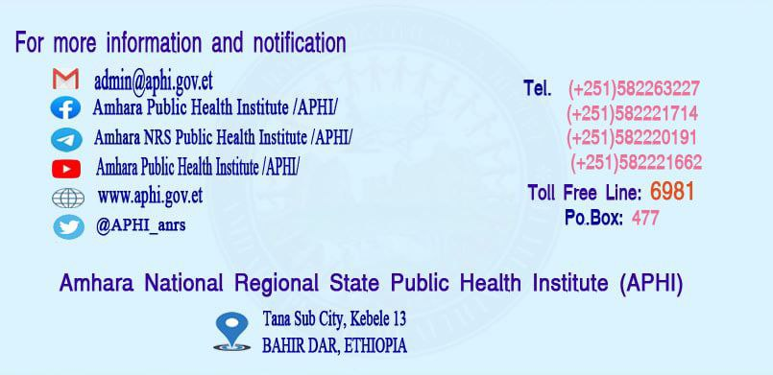
THANK YOU

