Slide 1

Determinants of Eye Health Service Utilisation in Central Sidama Zone, Ethiopia
Melese Kitu, Zelalem Mehari, Thomas Tusa, Belayneh Bekele, Addisu Worku, Aklog Getnet, Samson Tesfaye, Dawit Seyum, Alemayehu Sisay, Aklilu Haile, Ageru Kebede, Kebede Deribe, David Macleod, Andrew Bastawrous, Jacqueline Ramke, Matthew Burton, Esmael Habtamu
December, 2025
Bahir Dar, Ethiopia

Slide 2
Presentation outlines
Background
Objectives
Methods
Results
Conclusion
Recommendations
Acknowledgements
APHI-FHEIA 4th Joint International Annual Research Conference

Slide 3
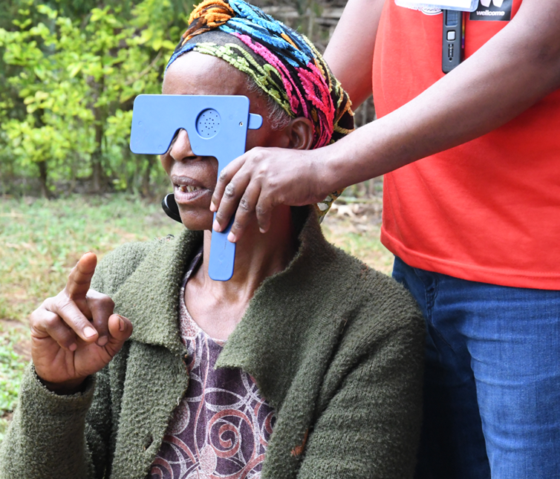
Background
The magnitude and distribution of vision impairment is hugely influenced by the utilisation of eyecare services by the community
Mainstreaming primary eye care into primary health care require understanding determinants of eye care service utilisation
We employed the Andersen behaviour model of health service use to address the evidence gap
APHI-FHEIA 4th Joint International Annual Research Conference

Slide 4
Objectives
To determine the prevalence of eyecare service utilization in Central Sidama zone, Ethiopia
To identify determinants of eye health service utilisation in Central Sidama zone, Ethiopia
To assess the association between VRQL and eye care service utilization
APHI-FHEIA 4th Joint International Annual Research Conference

Slide 5
Methods
Study design | A Cross sectional Mixed method: Nested within a population-based eye health survey
Study setting | Central Sidama zone, Sidama region, Ethiopia
Study period | March 23 up to April 09, 2025
Sample size | 2668 (Estimated from 5800 participants for eye health survey 46% are ≥18 years)
Inclusion | Age above 18+ years
Sampling method | Two-stage cluster sampling method 116 clusters were selected using probability proportional to size, and households were identified through compact segment sampling
Analysis | A Generalized Linear Mixed Model (GLMM), adjusted for household level clustering, was employed
Notes:
When we look at the methods we employed

Slide 6
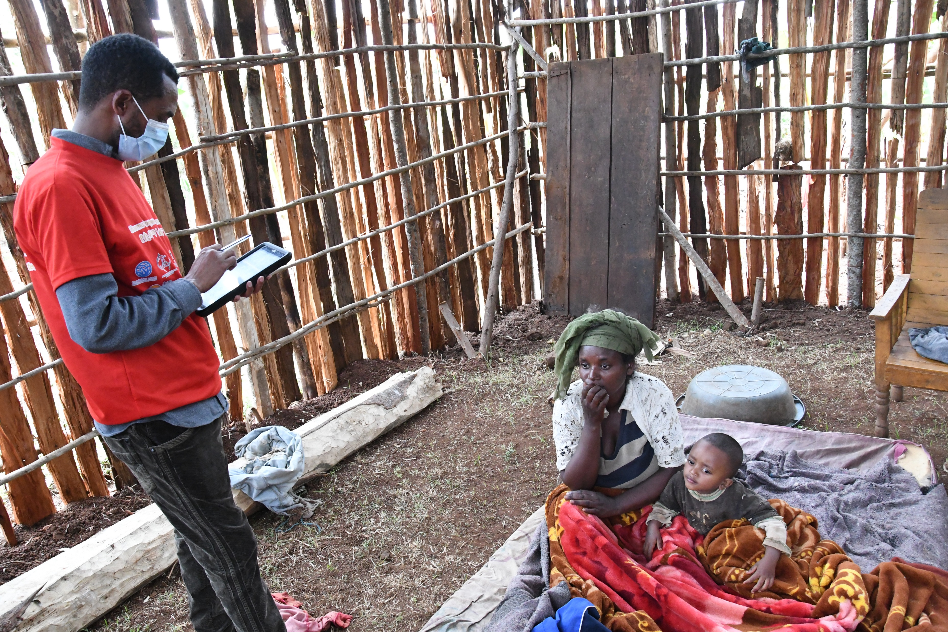
Methods
Data Collection
7-day training for data collectors
Piloted
Data collected using ODK, House to house
7 teams led by ophthalmologist
Tool derived from the Anderson model and pretested
APHI-FHEIA 4th Joint International Annual Research Conference

Slide 7
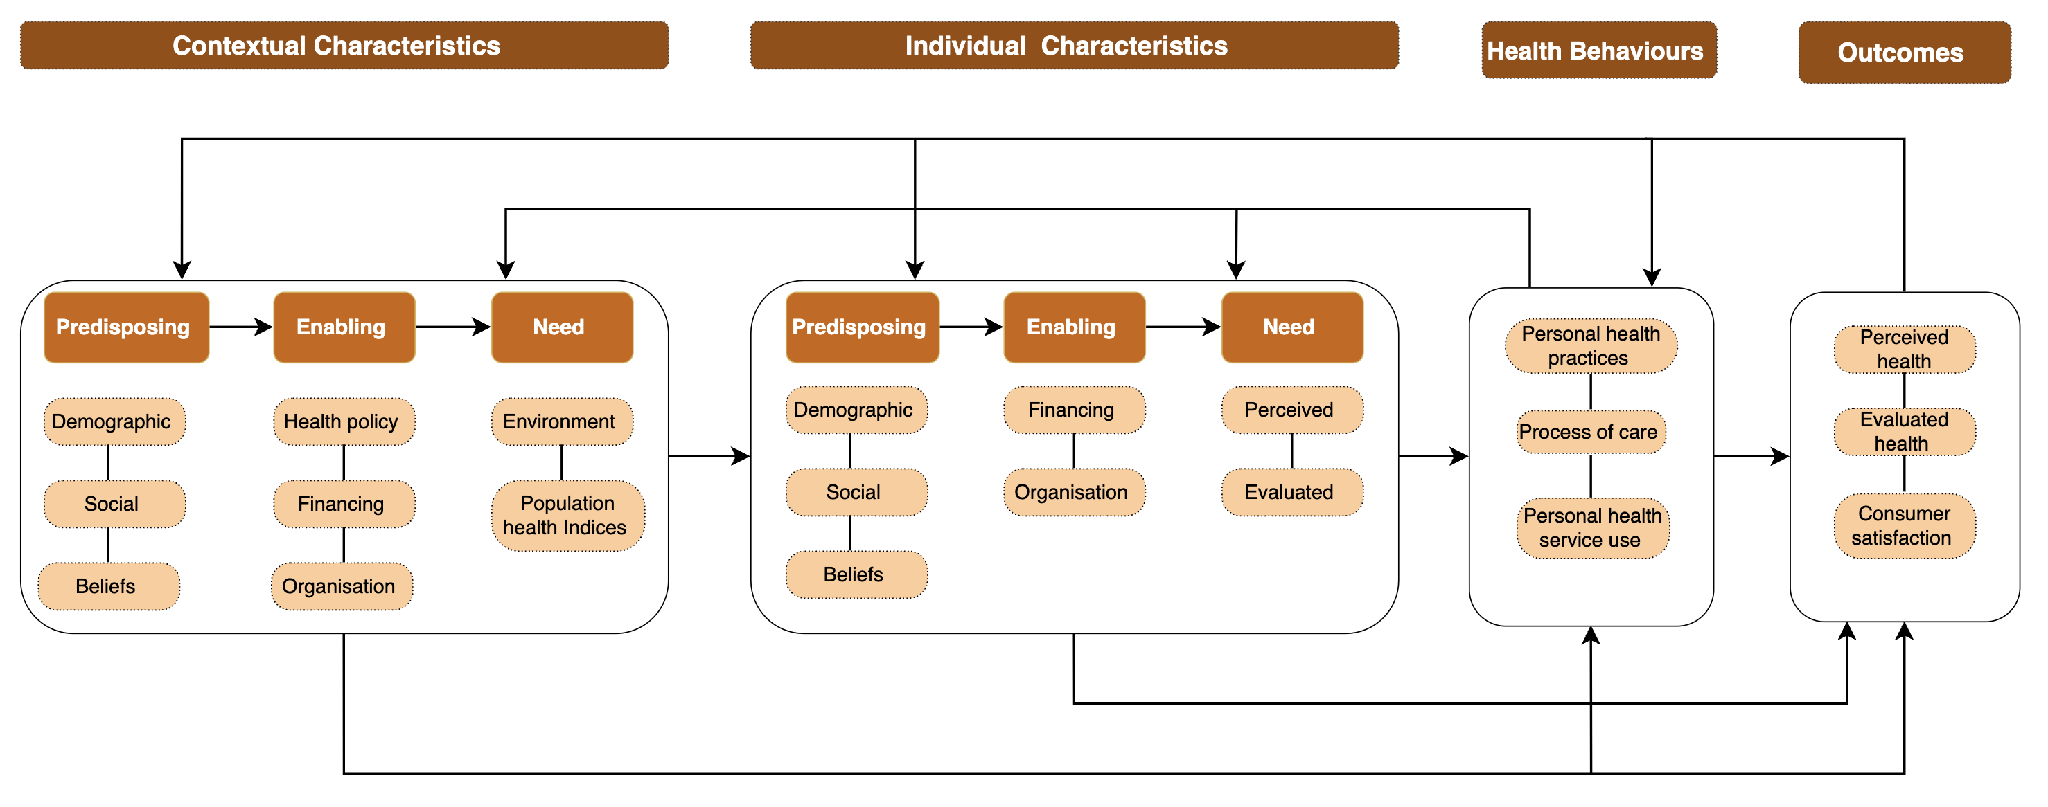
Methods
Andersen Behaviour Model
APHI-FHEIA 4th Joint International Annual Research Conference

Slide 8
Results - Participants
Variables | Categories n(%)
Age | Median (IQR) 35 (25- 45) years
Gender | Females 1731 (53.7%)
Residence | Rural 2876 (89.3%)
Occupation | Farmers 1091 (33.9%)
Educational status | Primary education 1613 (50.1%)
Martial status | Married 2,501 (70.5%)
Health insurance | Member 1135(35.2%)
Wealth status | Poor 1234 (38.4%)
 | Middle 637 (19.8%)
 | Rich 1346 (41.8%)

Slide 9
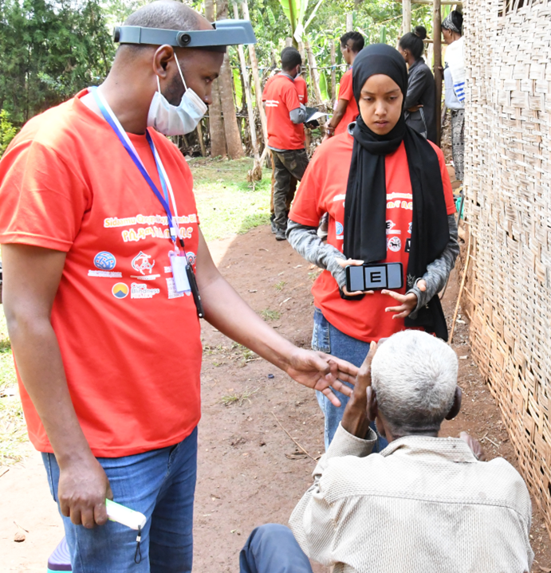
Results
A total of 3221/3456 (93.2%) were interviewed
Service utilization with in the past one year
Eye care services: 66/3221 (2.05%) [95% CI: 1.61% – 2.60%)
General health services: 414/3221 (12.85%) [95% CI:11.74%-14.05%]
Traditional or religious services for eye health: 8/3221 (0.25%)
APHI-FHEIA 4th Joint International Annual Research Conference

Slide 10
Determinants of Eye Health Service Utilisation
Predisposing factors
Older age of household heads: AOR=1.05 [95%CI: 1.03-1.07]
Employed: AOR=2.9 [95%CI: 1.49 – 5.58]
Secondary education: AOR= 2.86 [95%CI: 1.15-7.14]
Married: AOR =4.14 [95%CI: 1.56– 10.93]
Positive belief toward eye health services: AOR= 4.62 [95%CI: 2.73 – 7.82]
Higher number of dependents in a household AOR= 1.20 [95%CI: 1.02 – 1.42]
Enabling Factors
Urban: AOR= 3.86 [95% CI: 2.09 – 7.11]
Health insurance enrolment: AOR= 1.84 [1.11 – 3.05]
Need factors
Non-Vision Impairing(NVI) ocular morbidity: AOR 1.86= [95%CI: 1.08 – 3.2]
Self reported eye problem: AOR=10.09 [95% CI: 5.43- 18.75]
Notes:
Secondary education compared with non-educated, Married =compared with singles
Employed= compared with farmers

Slide 11
Determinants of Eye Health Service Utilisation
Significant Factors From Overall Model | Adjusted OR | 95% CI
Older age of household heads | 1.02 | 1.002 – 1.04
Health insurance enrolment | 2.07 | 1.15 – 3.75
Married | 4.18 | 1.40 – 12.52
Higher number of dependents in a household | 1.22 | 1.01 – 1.47
Positive belief toward eye health services | 4.29 | 2.33 – 7.91
Transport availability | 3.16 | 1.27 – 7.87
NVI ocular morbidity | 1.78 | 1.02 – 3.11
Self reported eye problem | 7.58 | 3.77 – 15.23

Slide 12
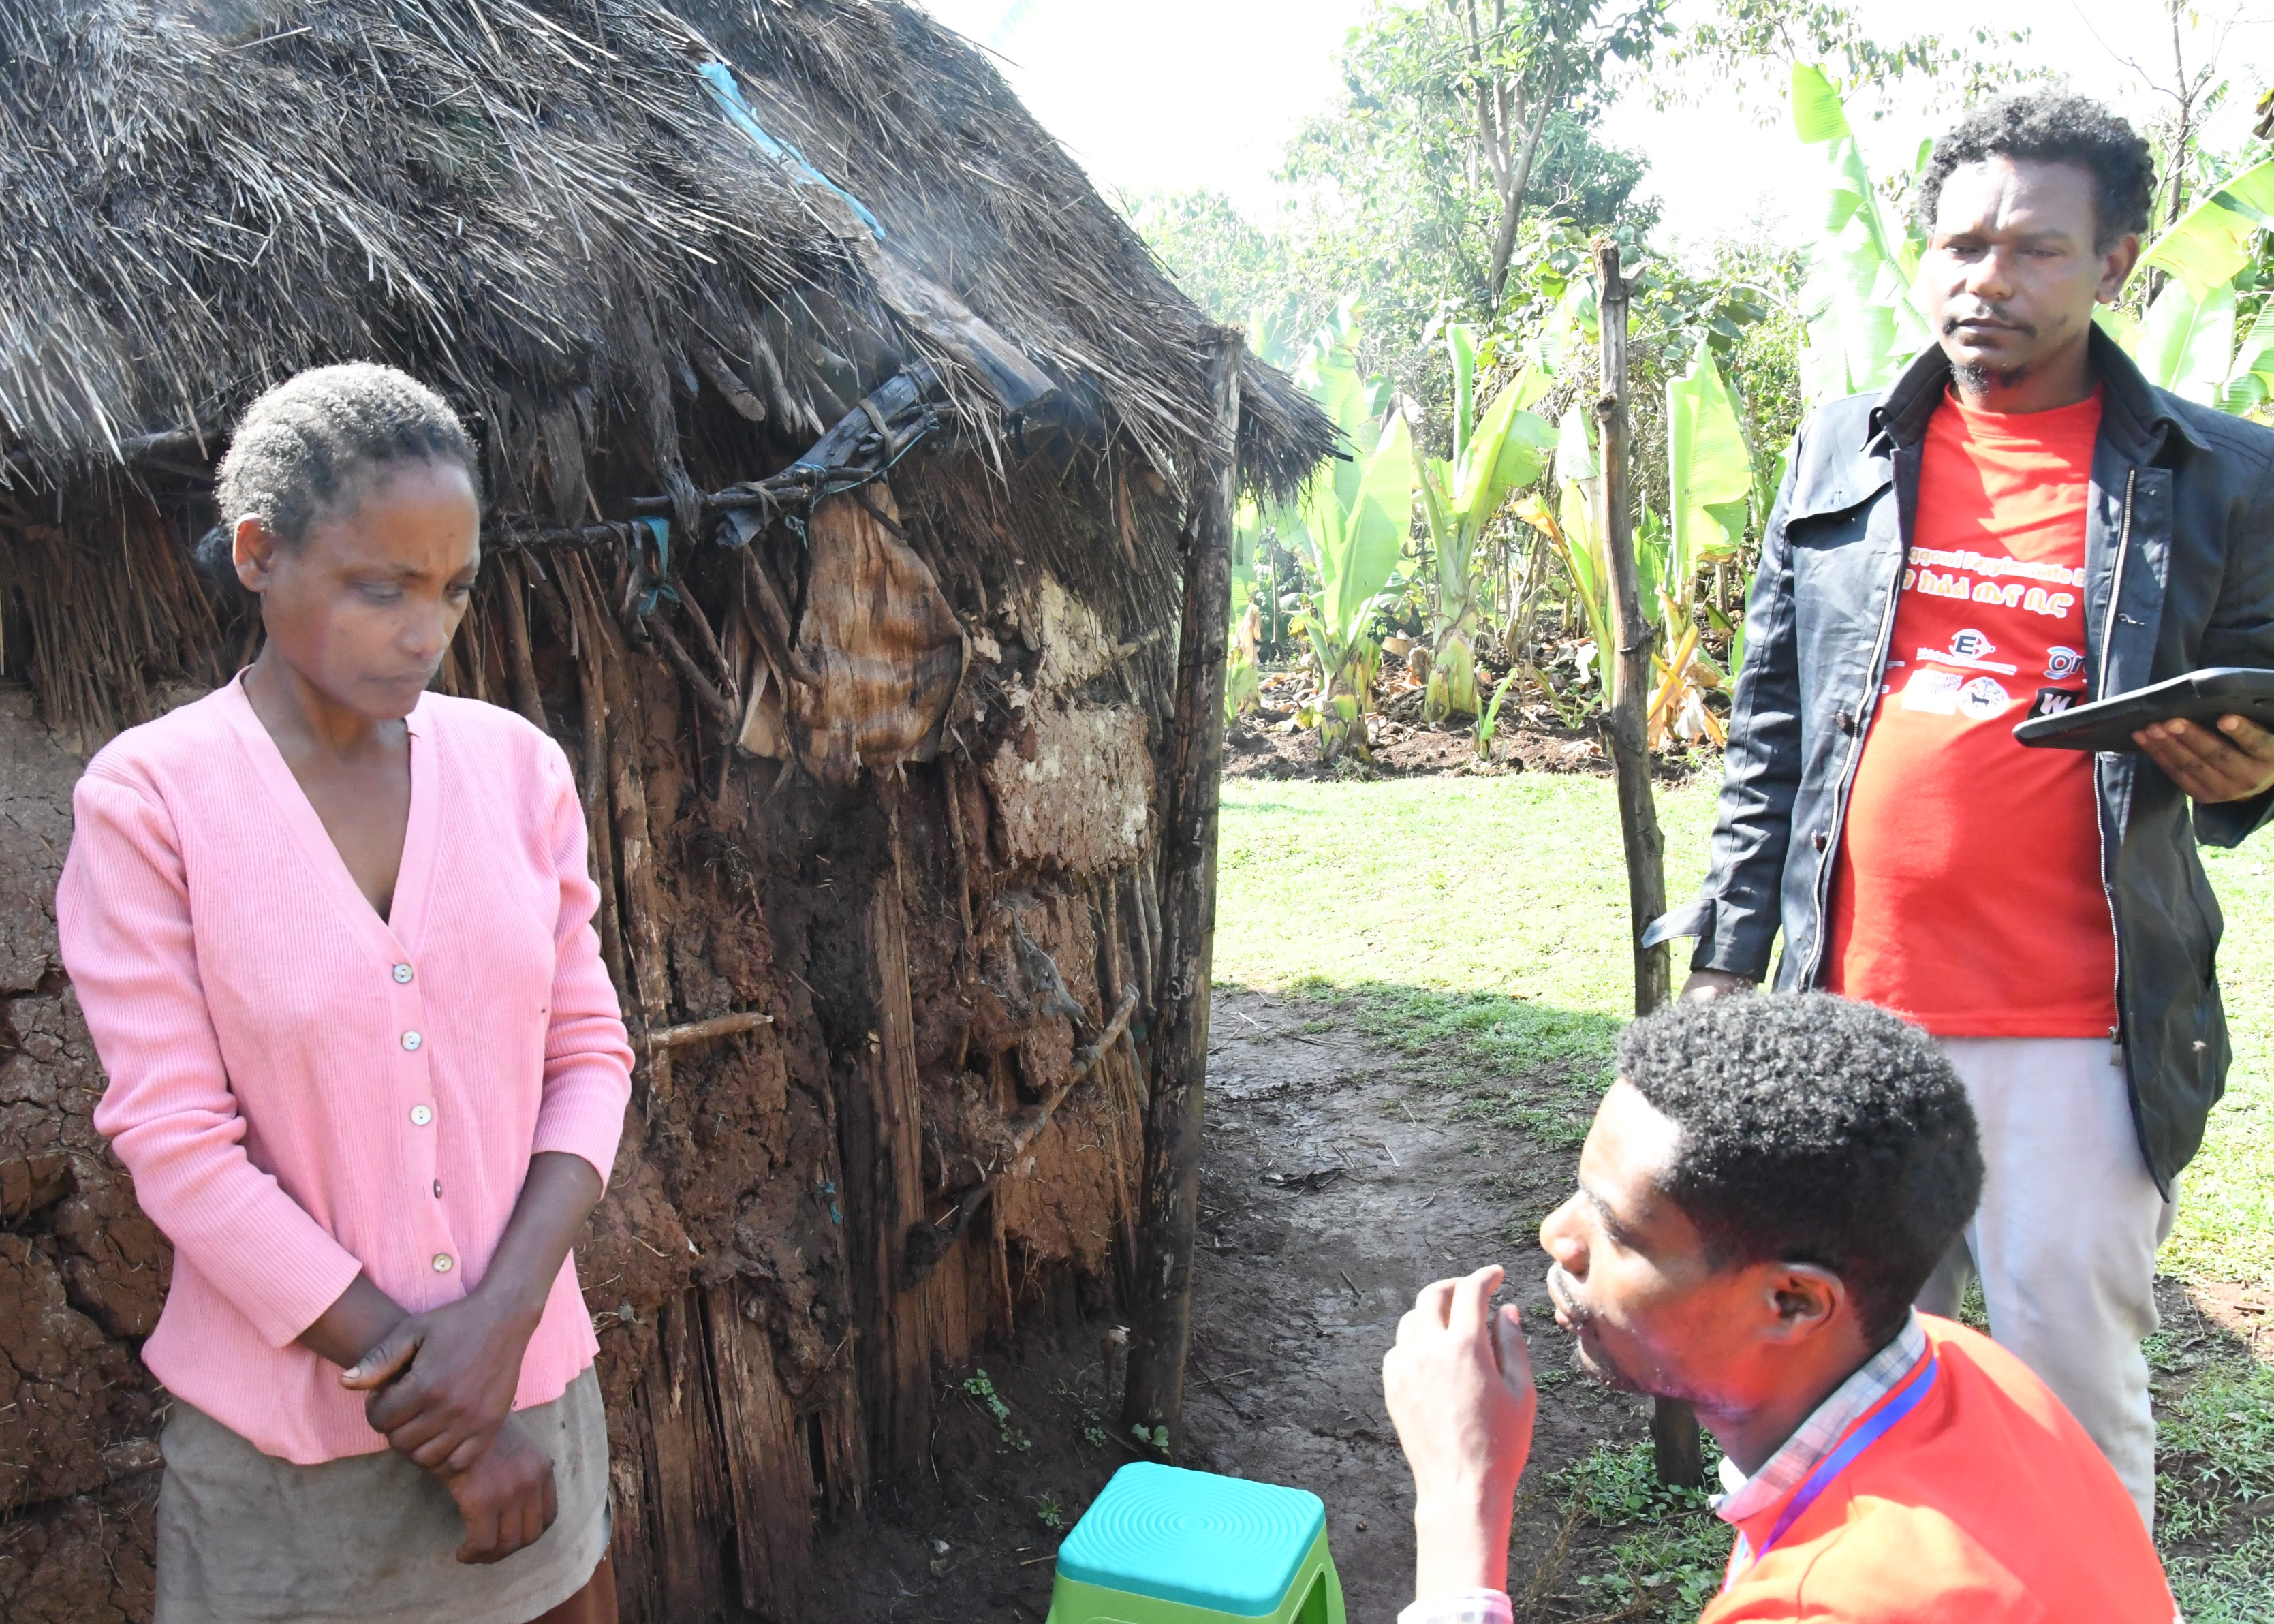
Household-Level Clustering
The ICC was 0.081 (95% CI: 0.0005–0.9443)
Household-level clustering accounts for 8.1% of variation in eye health service utilization
Notes:
8.1% of the variation in eye health service use is due to households being different.

Slide 13
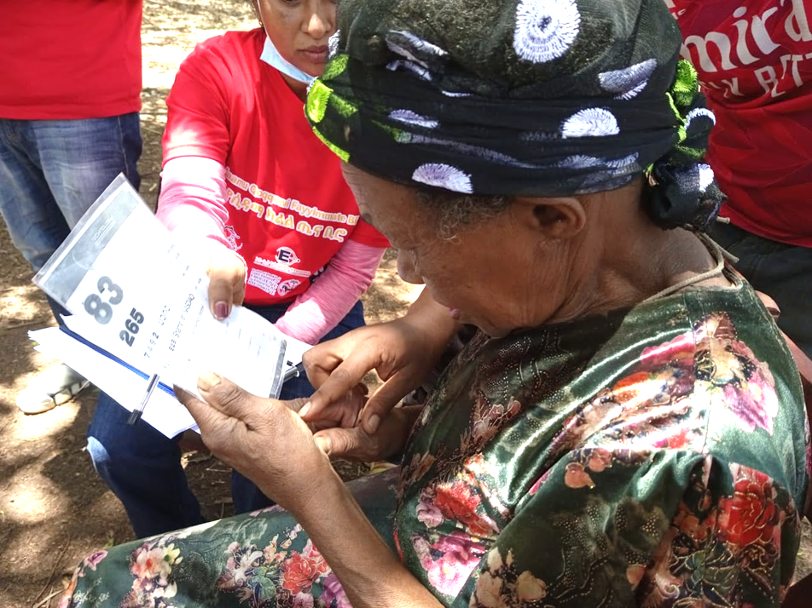
Vision-Related Quality of Life (VRQoL)
Mean VRQoL score was significantly lower among non-utilizers compared to those who utilized eyecare services
Mean difference = –3.14; [95% CI: –6.03 to –0.25], p = 0.028

Slide 14
Conclusion
Eye health service utilisation was poor
Influenced by the limited primary eye health services in the study area?
Most variation occurred at the individual level, but the household context still contributed a noticeable share
NVI ocular morbidity and self reported ocular morbidity were significantly associated with health facility visit, but not visual impairment
Other key determinants: marriage, positive belief towards eye health, transport availability and health insurance enrolment
APHI-FHEIA 4th Joint International Annual Research Conference

Slide 15
Recommendations
Establish equitably accessible primary eye health services integrated with the general health care system
Targeted and family centred approaches (farmers, illiterate, without civil partner, and younger households)
Community awareness through health education & promotion
Comprehensive vision and eye health screening
Build community trust
Strengthen and expand community-based health insurance (CBHI)
APHI-FHEIA 4th Joint International Annual Research Conference

Slide 16







Acknowledgement
Funder
Partners

Slide 17
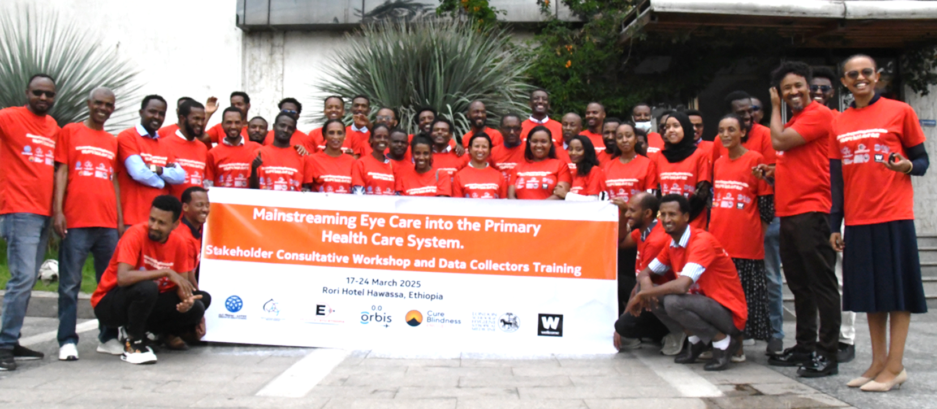
THANK YOU

